Slide 1

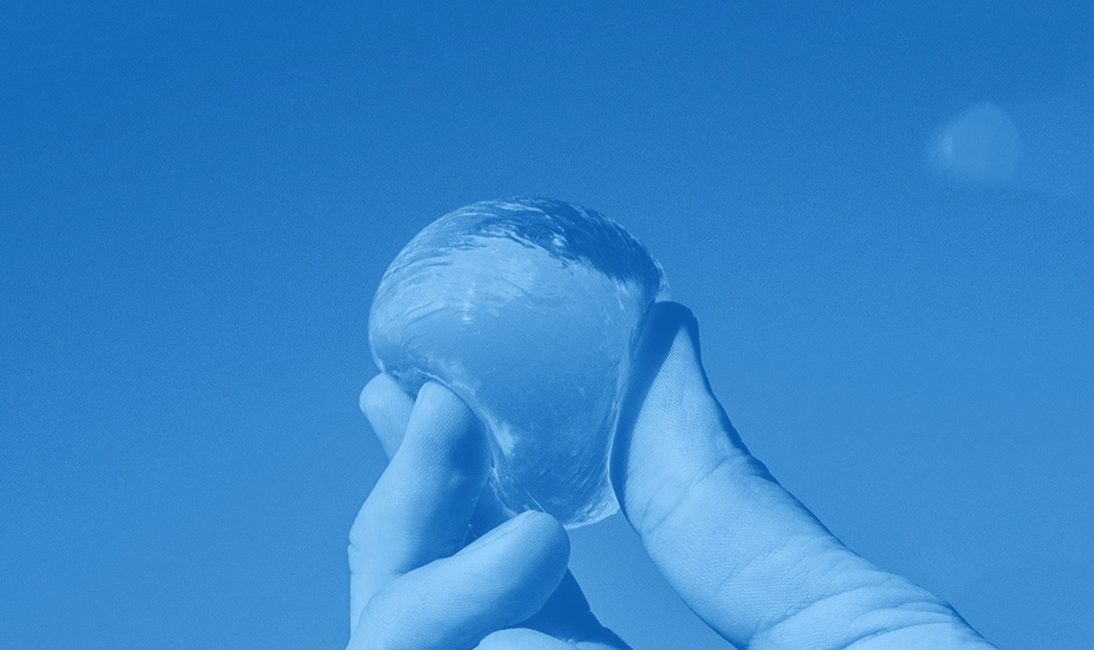

ECO-FRIENDLY
WATER BOTTLE

Slide 2
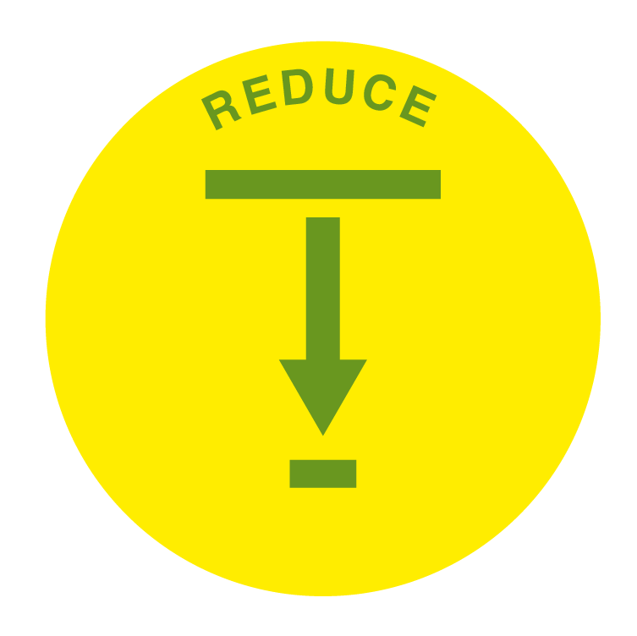
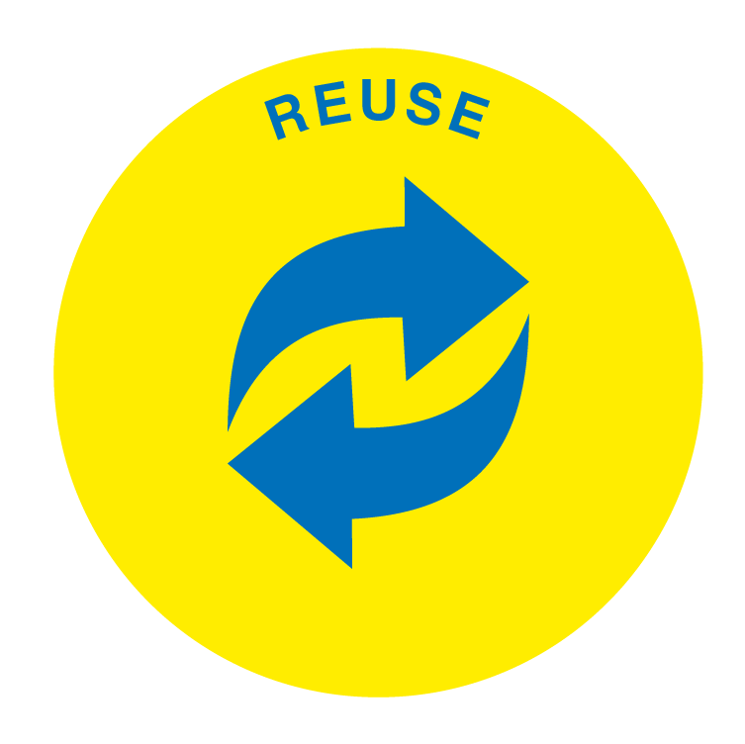
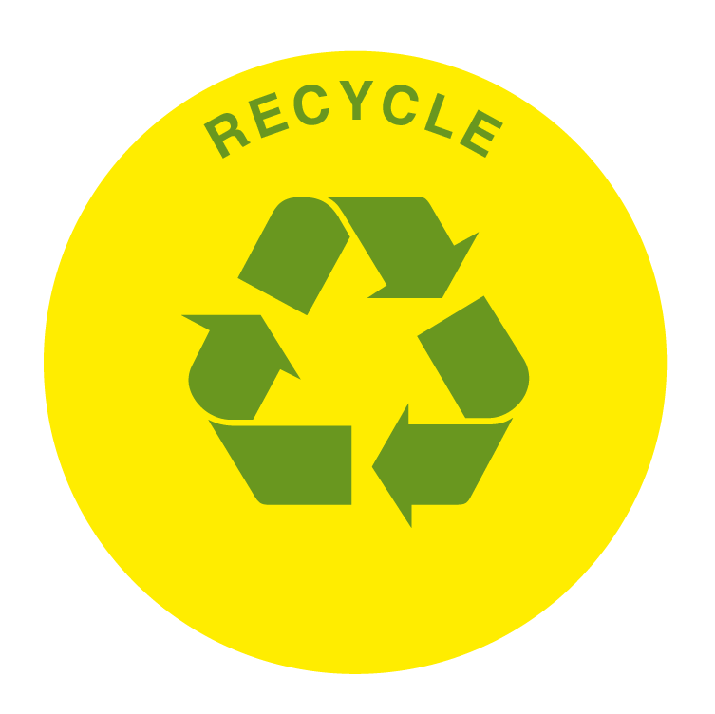

Reduce
Reuse
Repair
Recycle

Slide 3

Eco-friendly water bottle video

Slide 4
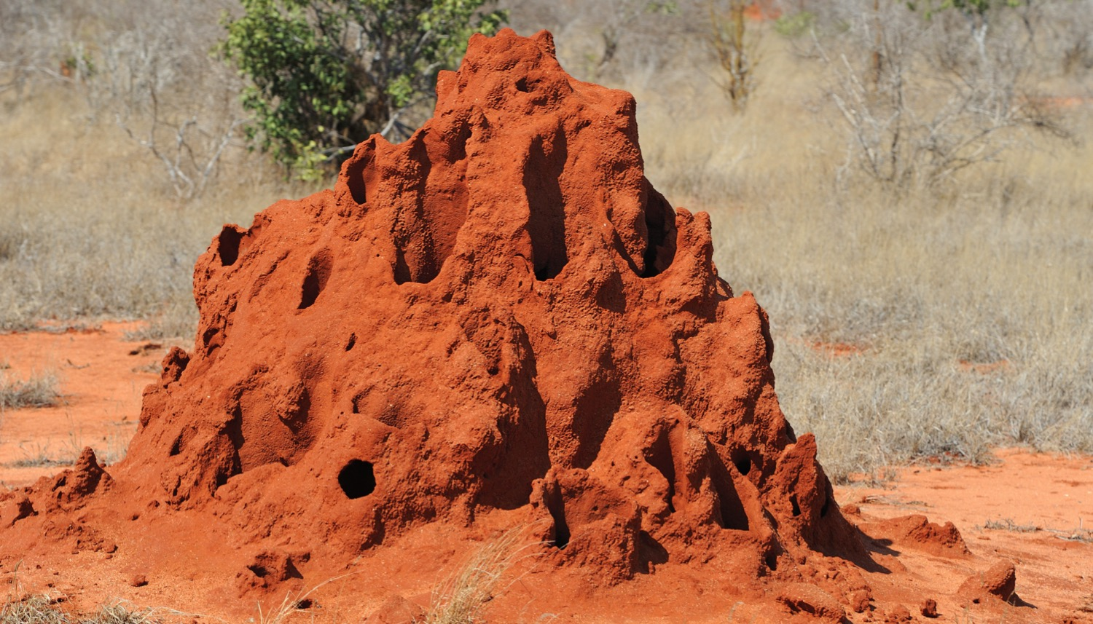
1 of 8
Termites have to keep the temperature of the termite mound constant. To do this, they build air vent tunnels to ensure that air circulates and prevents the mound overheating.
BIOMIMICRY
Match the natural world example with the invention or design it inspired.

Slide 5
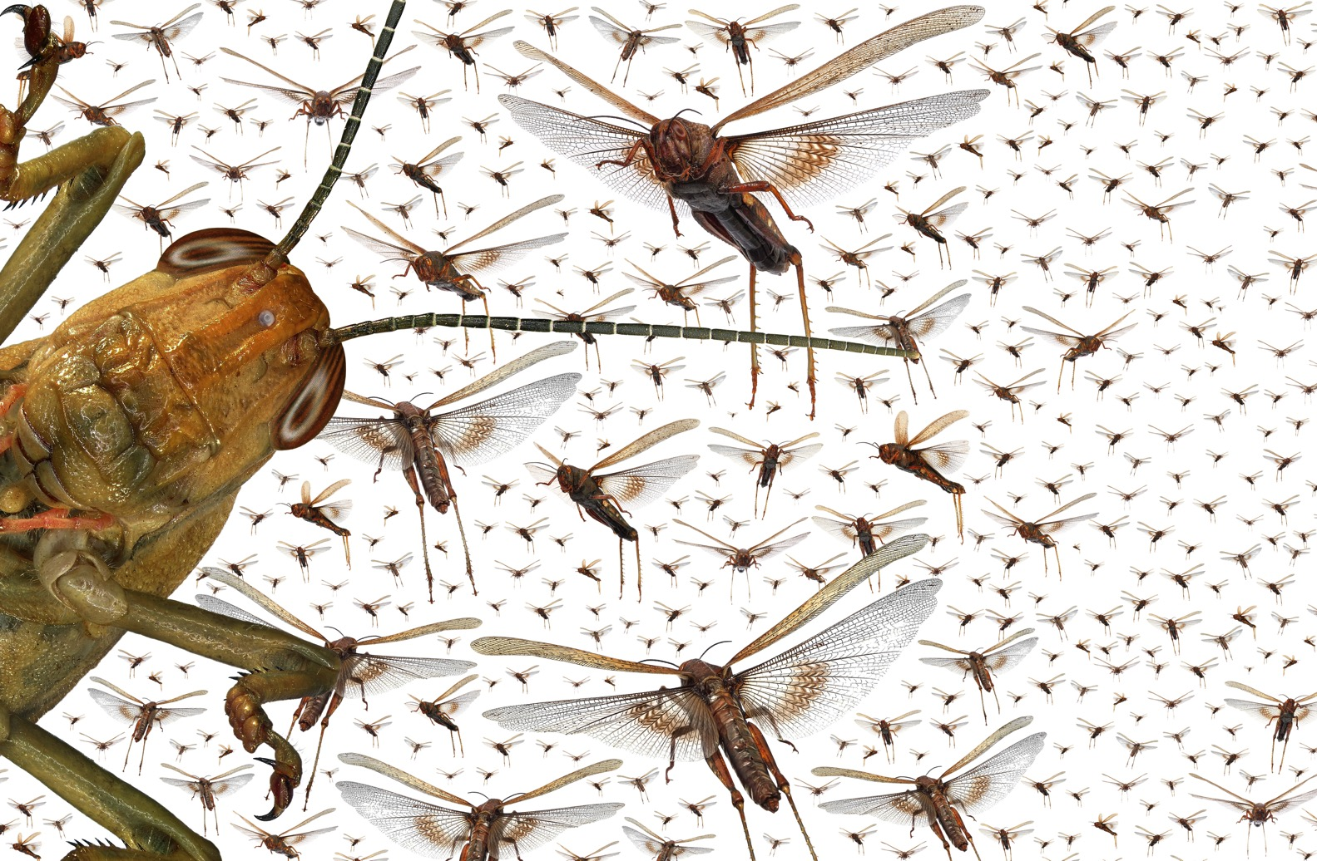
2 of 8
Locusts use complex eyes to see in several directions at once.
BIOMIMICRY
Match the natural world example with the invention or design it inspired.
BIOMIMICRY
Match the natural world example with the invention or design it inspired.

Slide 6
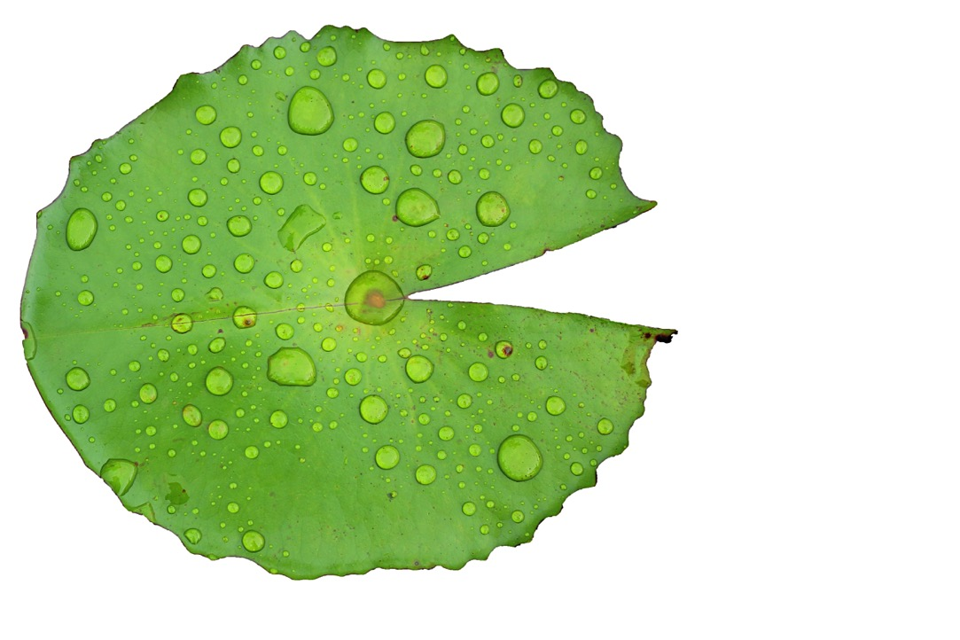
3 of 8
Lotus leaves have small bumps and ridges on their surface that help water run off the surface of the leaf. This helps to keep the leaves clean.
BIOMIMICRY
Match the natural world example with the invention or design it inspired.
BIOMIMICRY
Match the natural world example with the invention or design it inspired.

Slide 7
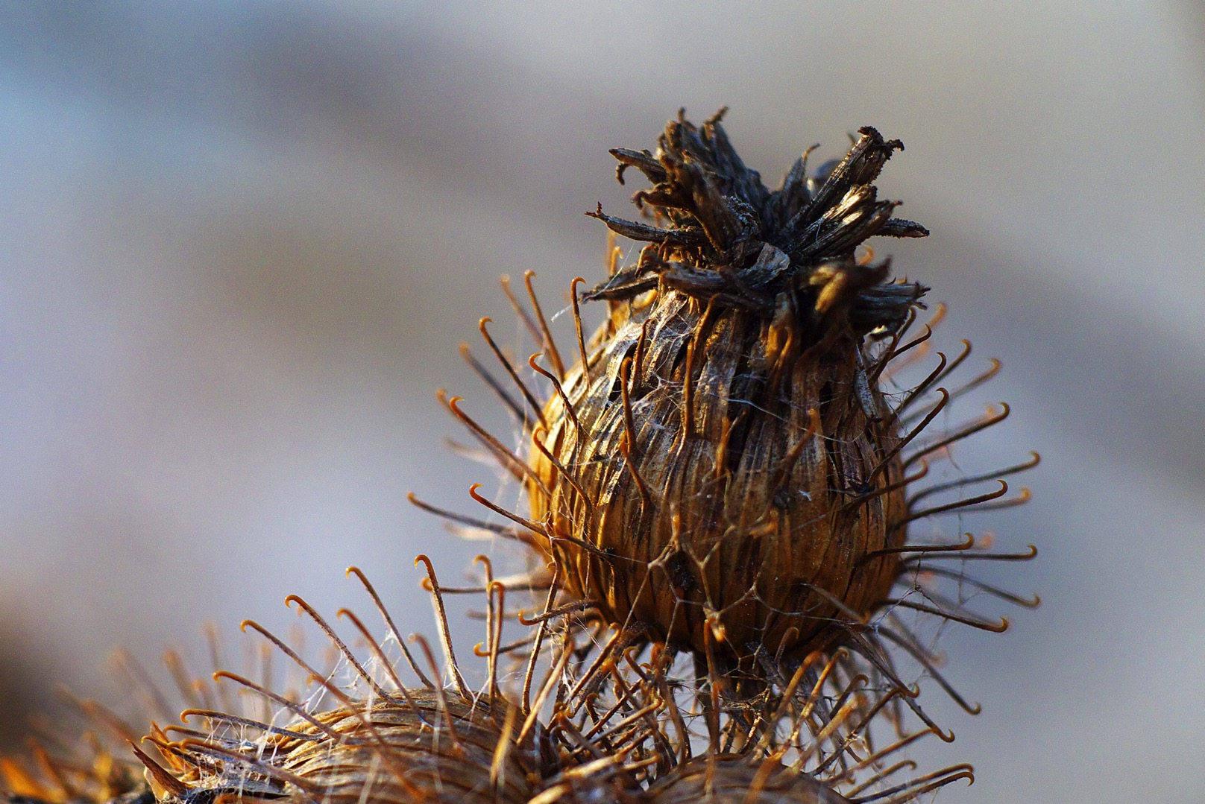
4 of 8
Burdock burrs, the seeds of the burdock plant, are covered in tiny hooks which attach to an animal’s
fur. The animal then carries them around until they fall off, which helps
to spread the seeds.
BIOMIMICRY
Match the natural world example with the invention or design it inspired.
BIOMIMICRY
Match the natural world example with the invention or design it inspired.

Slide 8
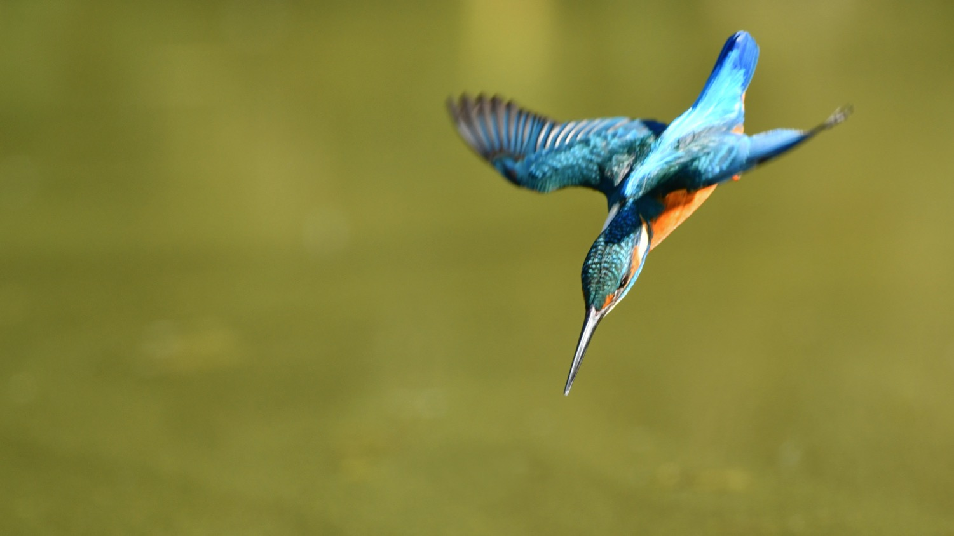
5 of 8
Kingfishers dive from the air into
the water, passing through two very different environments. Their beak provides an ideal shape for this impact, meaning that they barely make a splash, despite going at speeds of
up to 25 miles per hour.
BIOMIMICRY
Match the natural world example with the invention or design it inspired.
BIOMIMICRY
Match the natural world example with the invention or design it inspired.

Slide 9
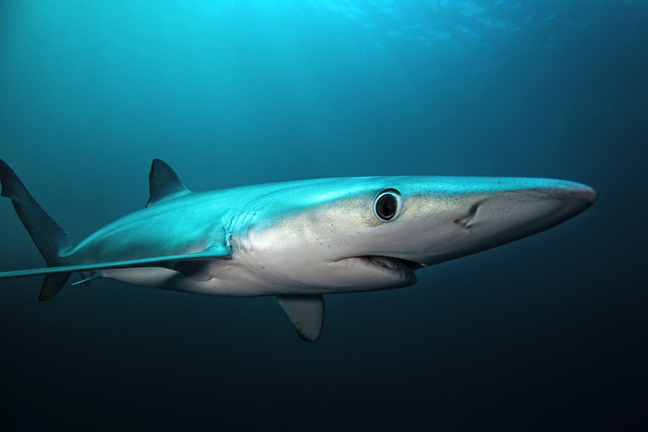
6 of 8
Shark skin has a surface texture that reduces the attachment of algae and microbes. This decreases the drag on the shark as it swims through the water.
BIOMIMICRY
Match the natural world example with the invention or design it inspired.
BIOMIMICRY
Match the natural world example with the invention or design it inspired.

Slide 10
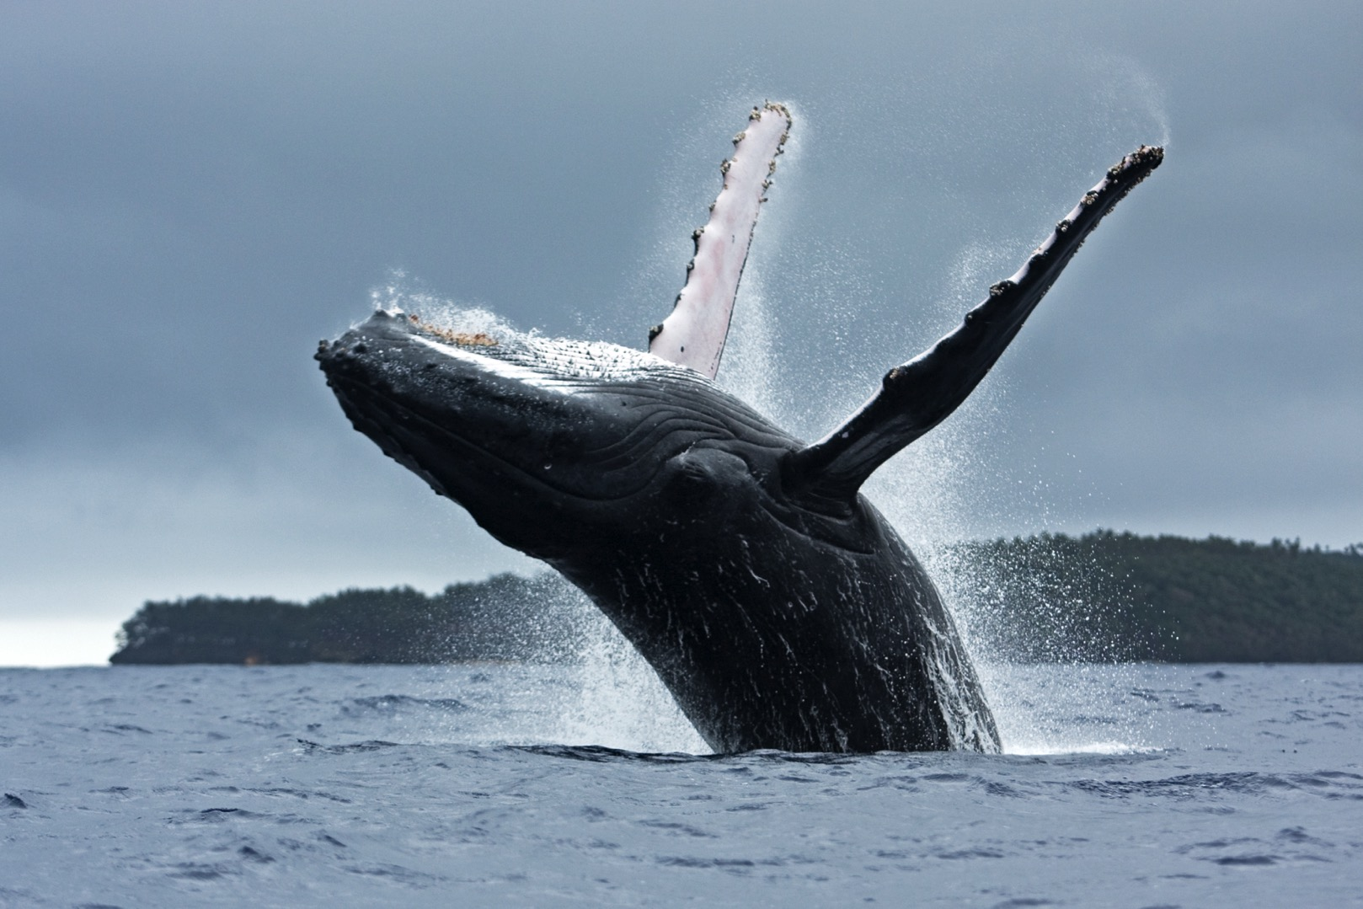
7 of 8
Humpback whales have bumps and ridges on their flippers that help the whale to slow down and turn more efficiently in water.
BIOMIMICRY
Match the natural world example with the invention or design it inspired.
BIOMIMICRY
Match the natural world example with the invention or design it inspired.

Slide 11
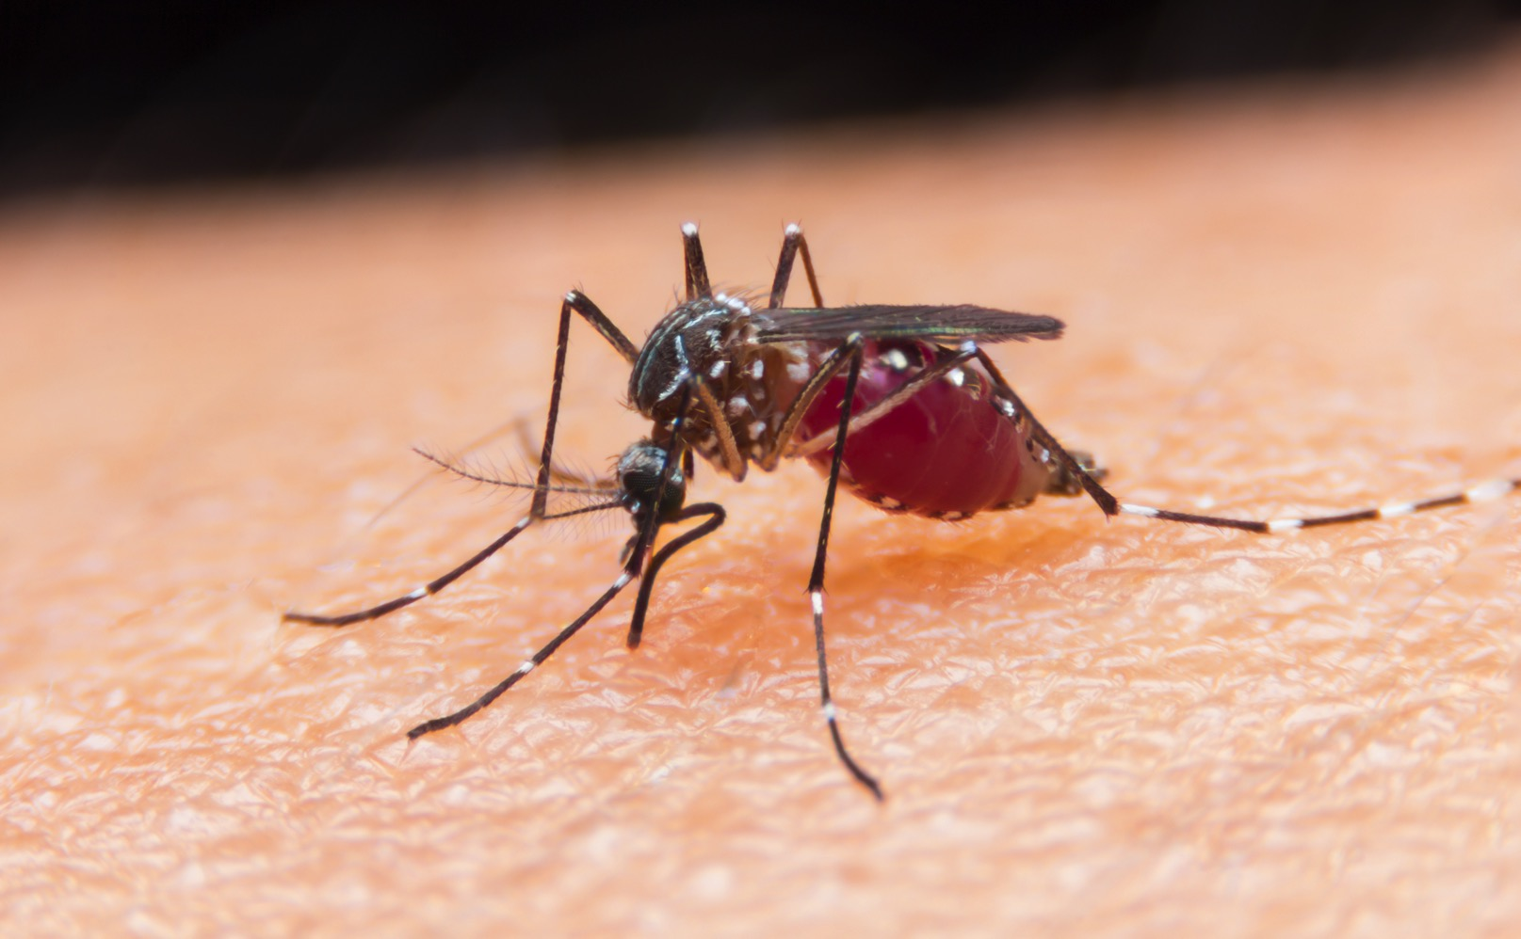
8 of 8
Mosquitoes have serrated piercing mouthparts. The shape of the mouthparts causes no pain when the mosquito pierces the skin and sucks the blood of its prey, meaning it can feed unnoticed.
BIOMIMICRY
Match the natural world example with the invention or design it inspired.
BIOMIMICRY
Match the natural world example with the invention or design it inspired.

Slide 12
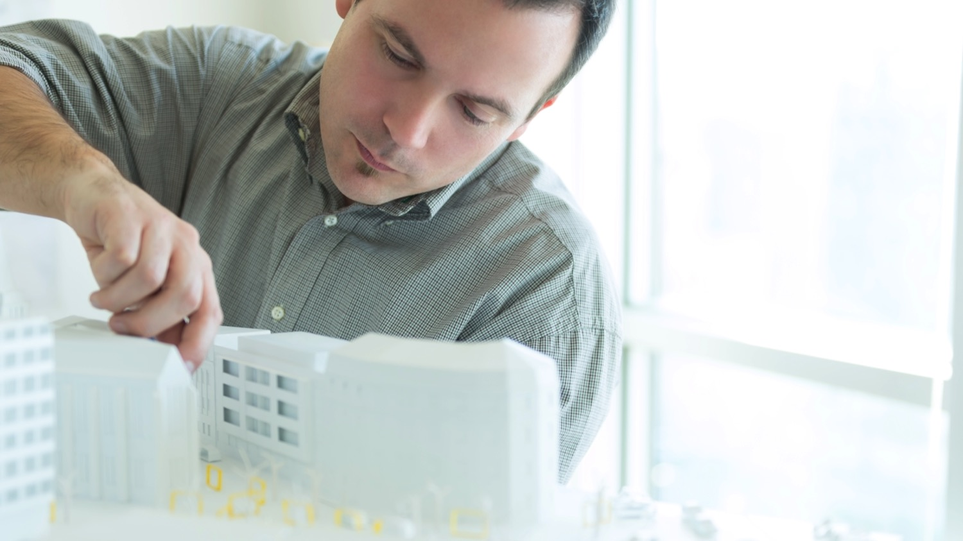
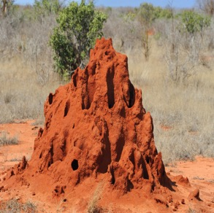
1 of 8
Termite mound design inspired:
Building design - Engineers are developing office blocks which are naturally ventilated to help control
the temperature of the buildings.

Slide 13
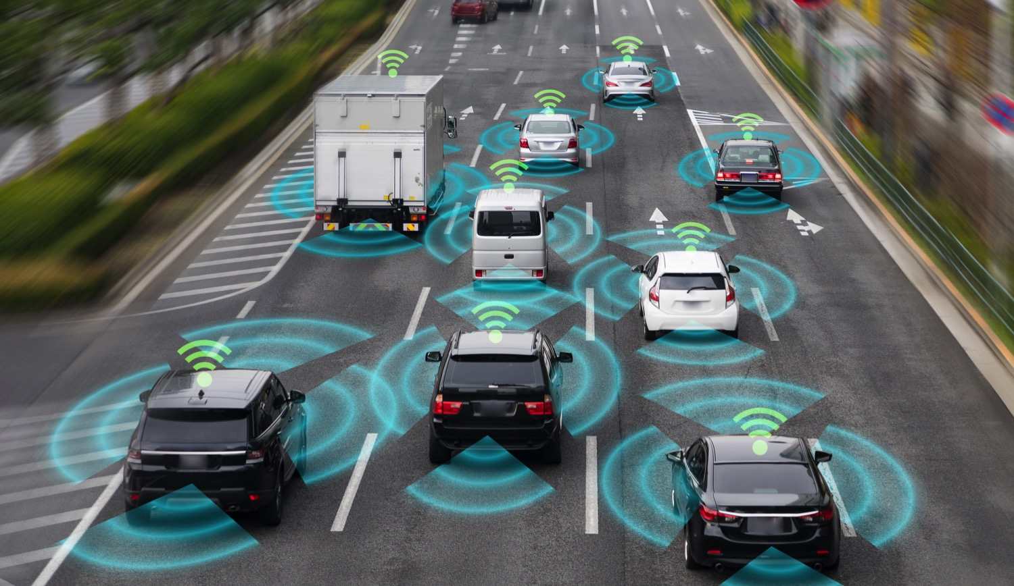
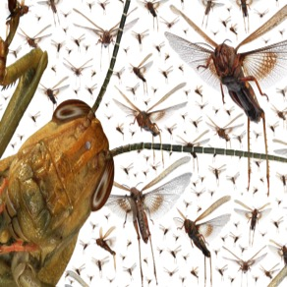
2 of 8
Locusts’ all seeing eyes inspired:
Car design - Car manufacturers developed sensors that can detect movement around the car in any direction, and alert drivers that
they are in danger of a crash.

Slide 14
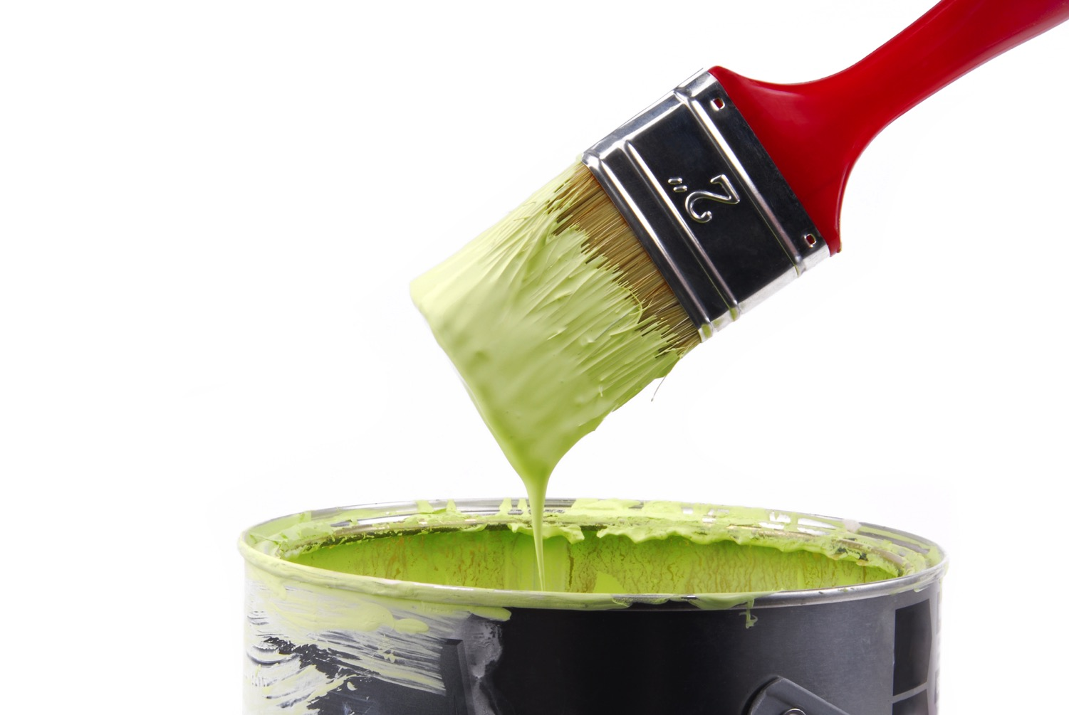
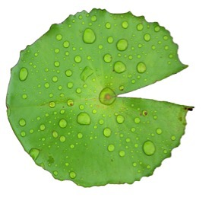
3 of 8
Lotus leaf bumps inspired:
Self cleaning paint - Researchers have designed paint which dries to leave bumps on the surface of the wall. These bumps help water run
off and remove dirt from the wall.

Slide 15
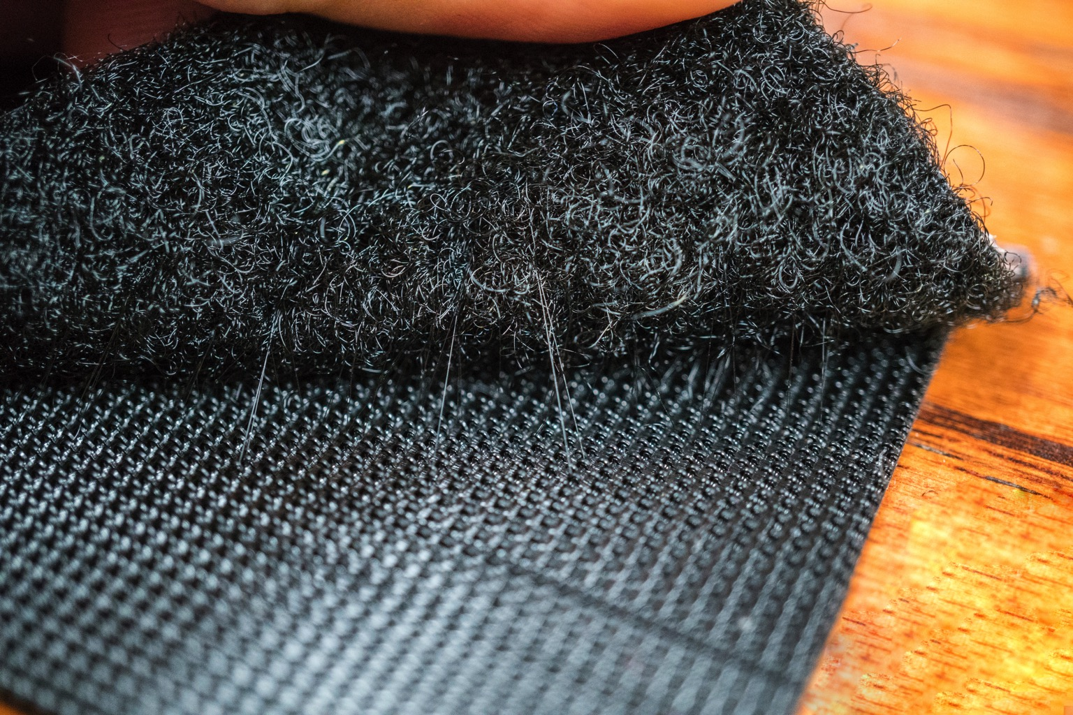
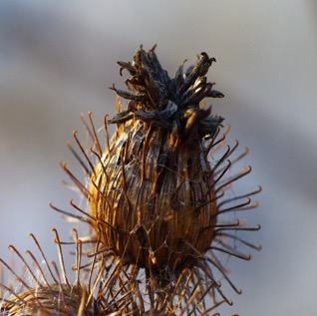
4 of 8
Burdock burr hooks inspired:
Velcro – Designed as a surface
with hooks and loops which can
stick together and then be pulled apart again. It is used in many products, including shoes.

Slide 16
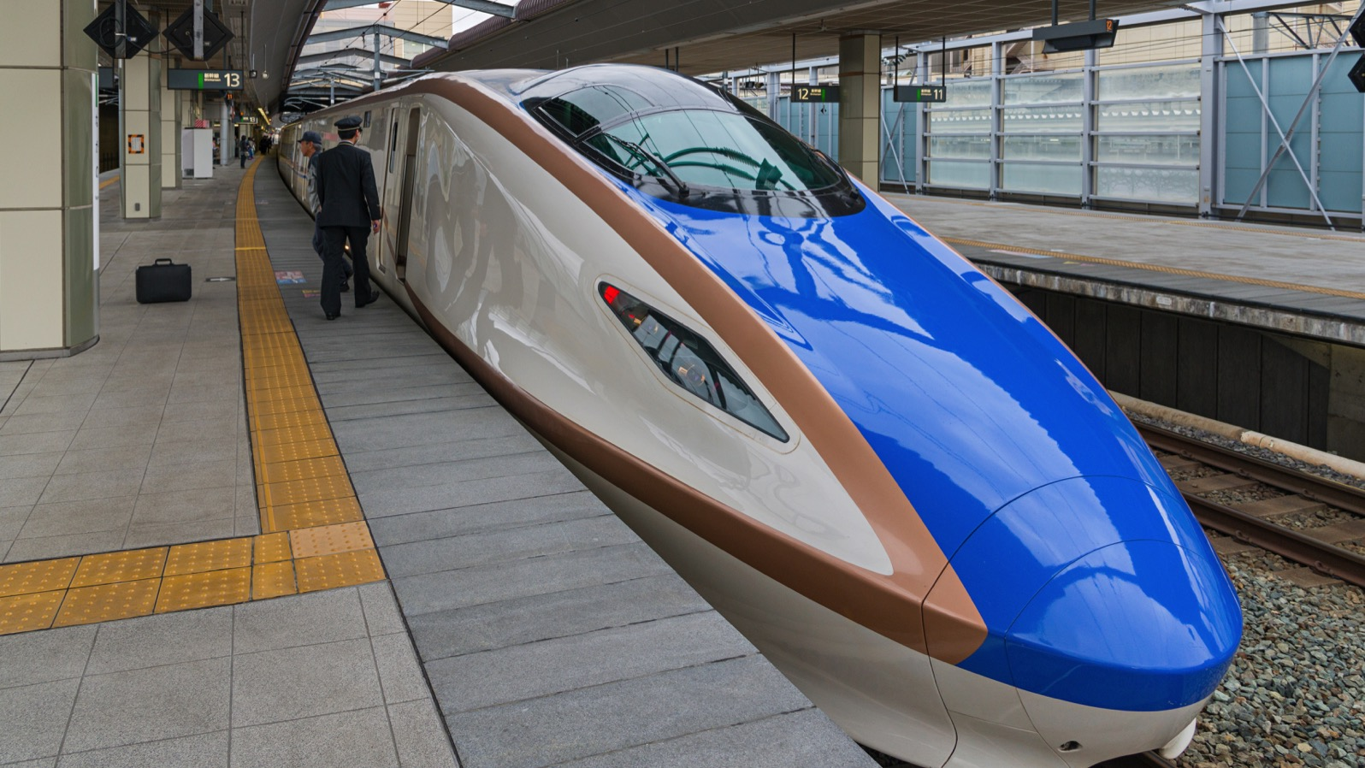
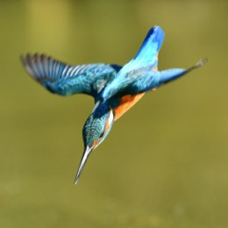
5 of 8
Kingfisher beak shape inspired:
Bullet train shape – The Shinkansen bullet train travels at high speed from tunnels to open air, both environments with very different air flow. The shape of the train’s long steel nose reduces noise and enables the train to travel faster.

Slide 17
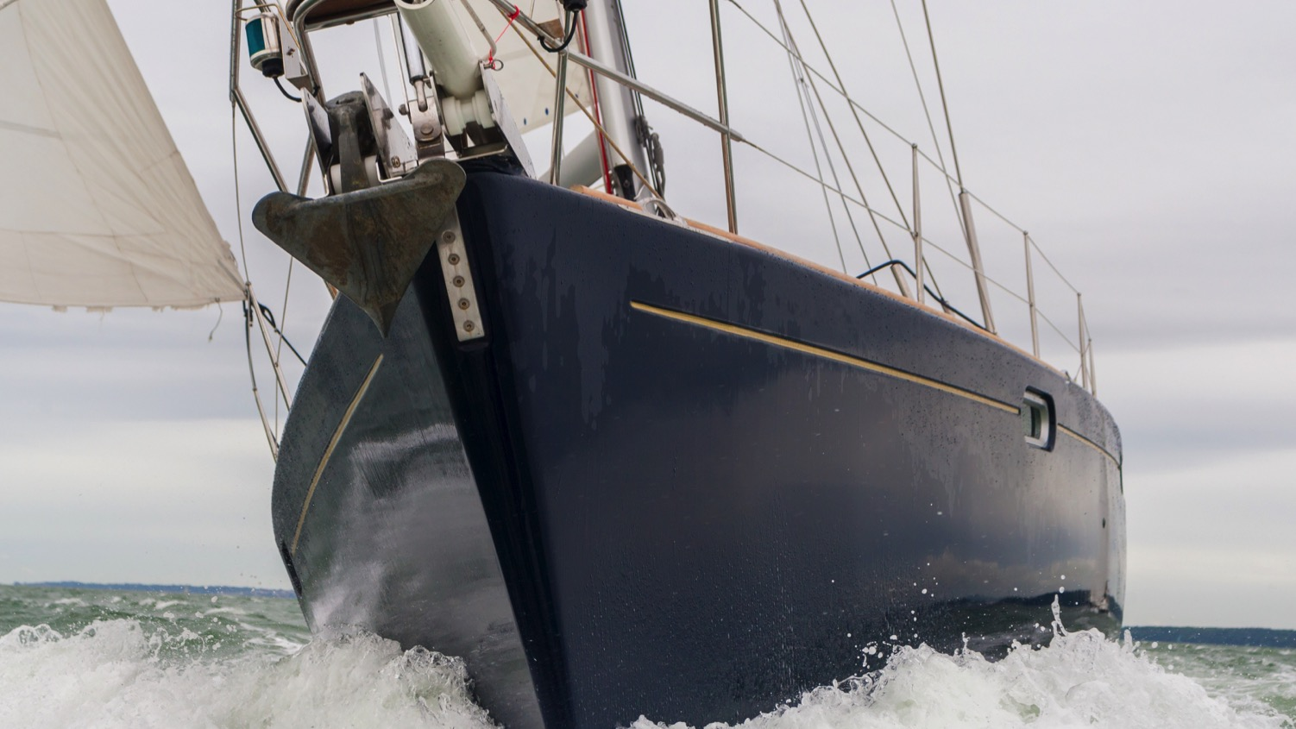
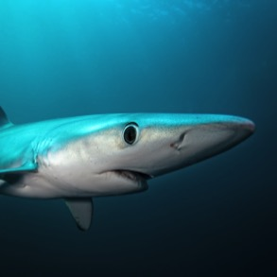
6 of 8
Algae-free shark skin inspired:
Ship engineering - Scientists have developed a patterned coating for ships that can prevent growth of algae on the hull, and reduce drag
as they move through the water.

Slide 18
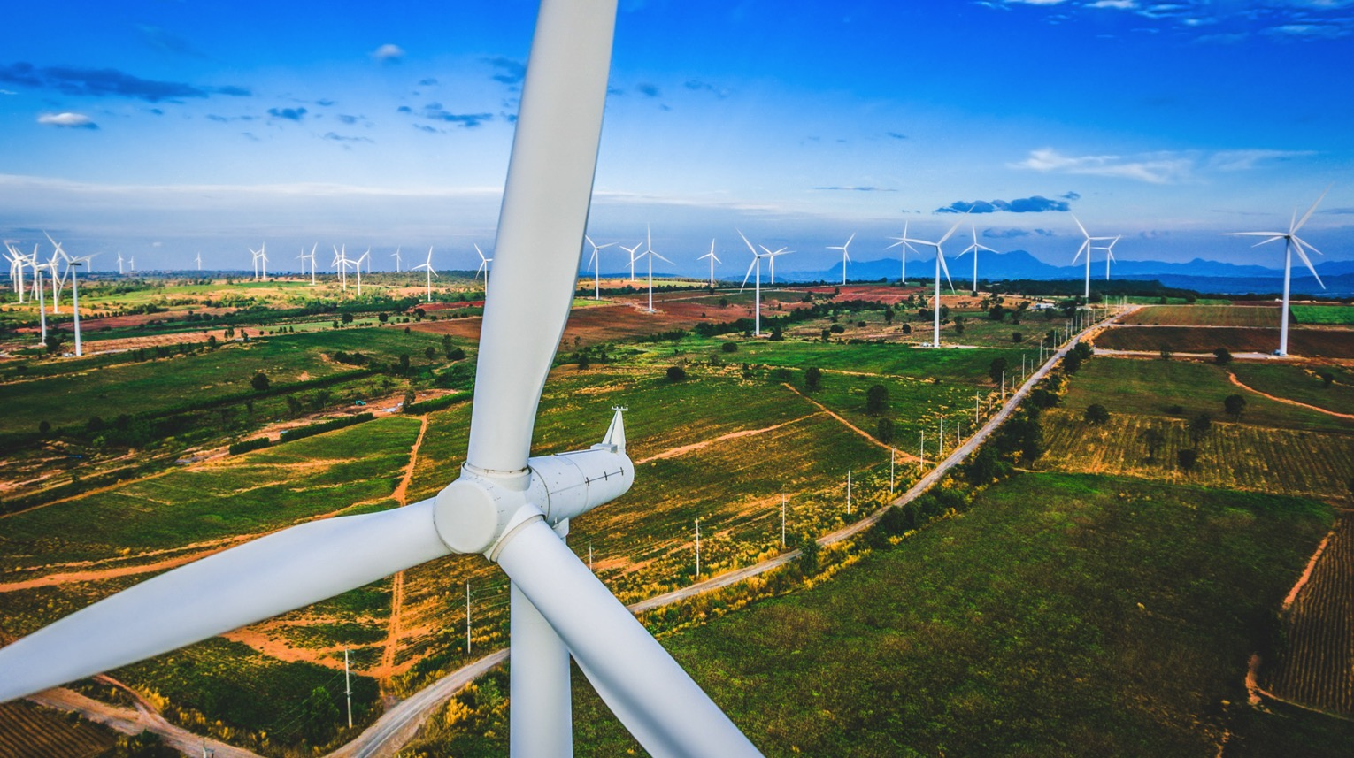
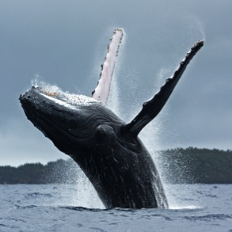
7 of 8
The bumpy fins of the humpback whale inspired
Wind turbine design - Researchers are developing wind turbines with bumps and ridges along the edge of the blade to improve the efficiency
of turbines.

Slide 19
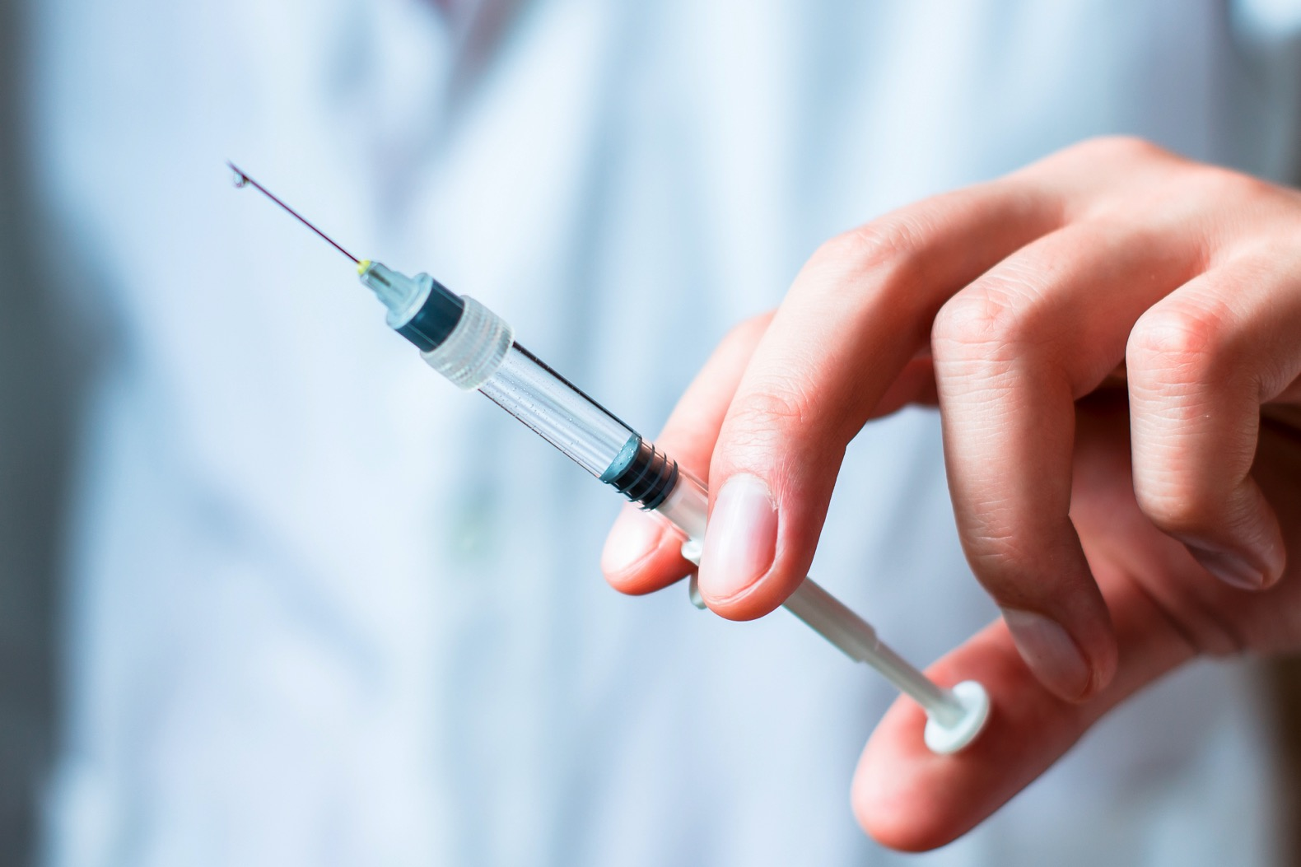
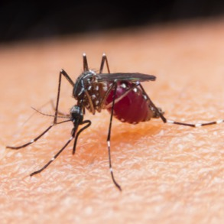
8 of 8
The pain-free mouthparts of the mosquito inspired:
Medical needle design - Researchers have designed serrated needles that have less contact with the nerves under the skin, causing less pain.

