Slide 1

6-8:
Building Claims from Evidence
Interactive Slides
Lesson Plan
Link to Student Sheet

Slide 2
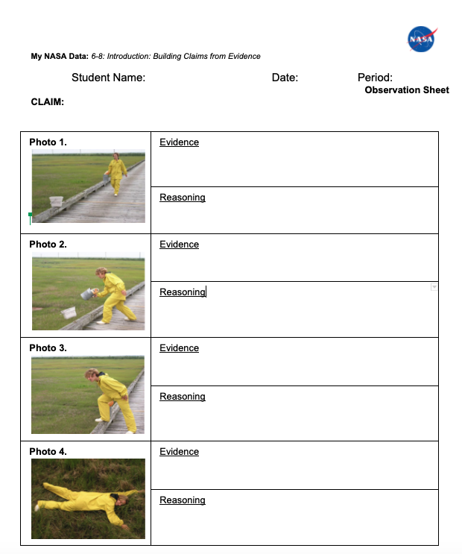
(Credit: NSF/COSEE-NOW)

Slide 3
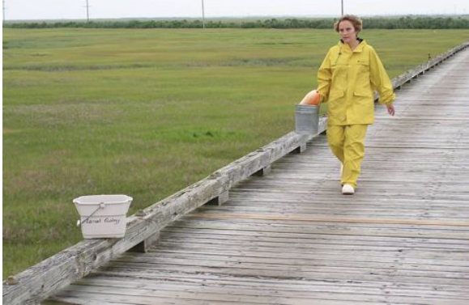
Photo 1:
Image Credit: COSEE NOW

Slide 4
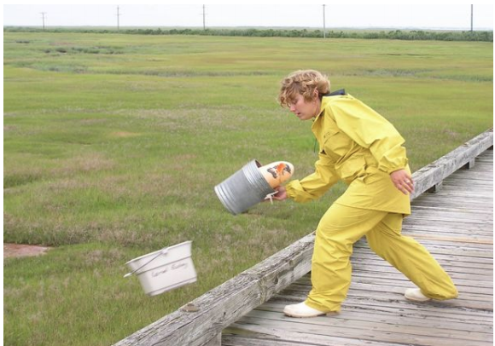
Photo 2:
Image Credit: COSEE NOW

Slide 5
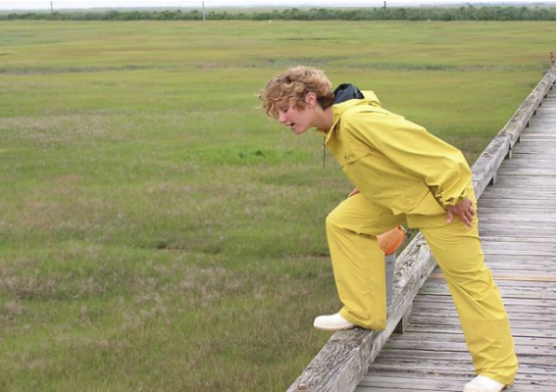
Photo 3:
Image Credit: COSEE NOW

Slide 6
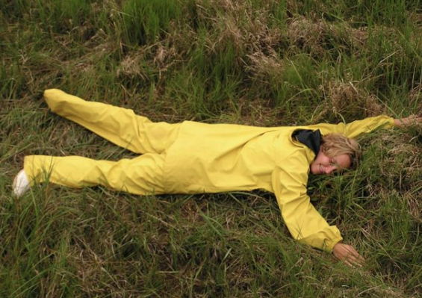
Photo 4:
Image Credit: COSEE NOW

Slide 7
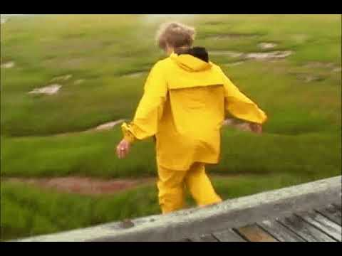
(Credit: NSF/COSEE-NOW)

Slide 8
C-E-R Rubric
Description | 3 Points | 2 Points | 1 Point | 0 Points
Claim | Makes an accurate and complete statement linking independent and dependent variables | Makes an accurate but incomplete claim addressing only one variable | Makes an inaccurate claim | Does not make a claim
Evidence | Provided appropriate and sufficient evidence to support claim using qualitative and quantitative observations of both the independent and dependent variables | Provide appropriate but insufficient evidence to support claim | Provides inappropriate evidence. The evidence does not support the claim | Does not provide evidence
Reasoning | Provides reasoning that connects each piece of evidence to the claim. Uses scientific principles to explain why the evidence supports the claim. | Provides appropriate but incomplete reasoning. Each piece of evidence is not supported by a line of reasoning. | Provides inappropriate reasoning. | Does not provide reasoning.
Total

