Slide 1




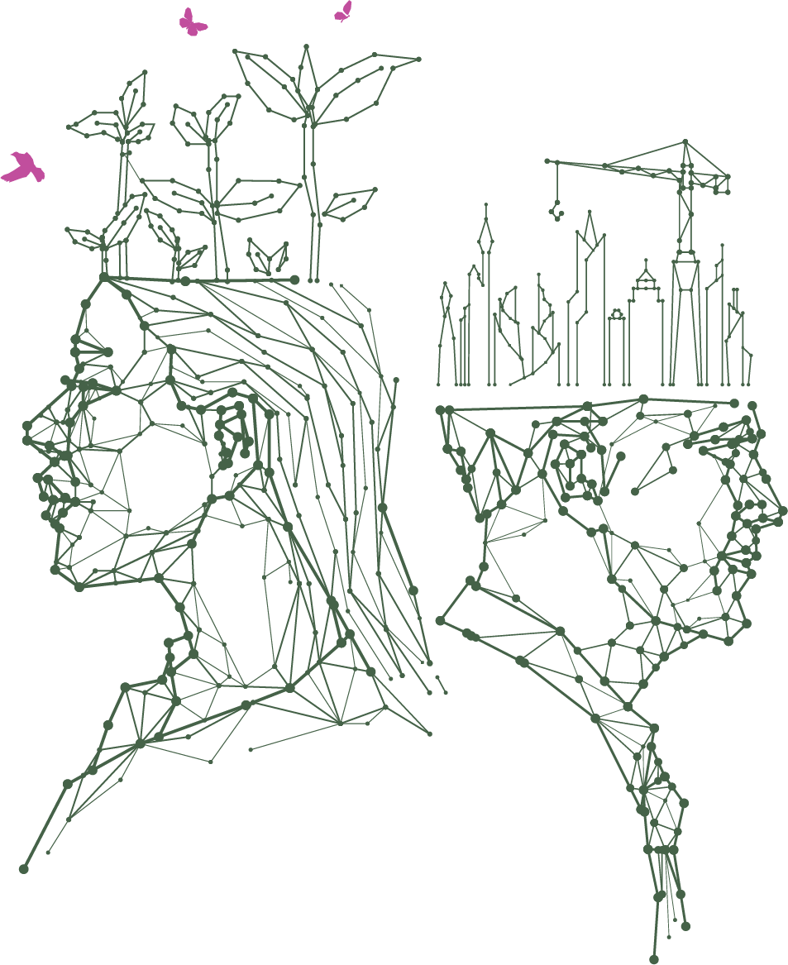
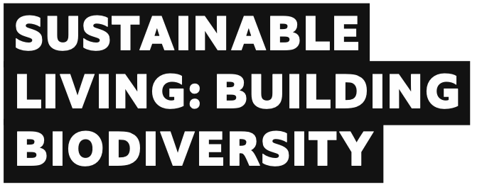


This resource is part of a Topical Talk Headline, produced by The Economist Educational Foundation. Please find the original version of the resource here: bit.ly/3YP6Xpt

Slide 2
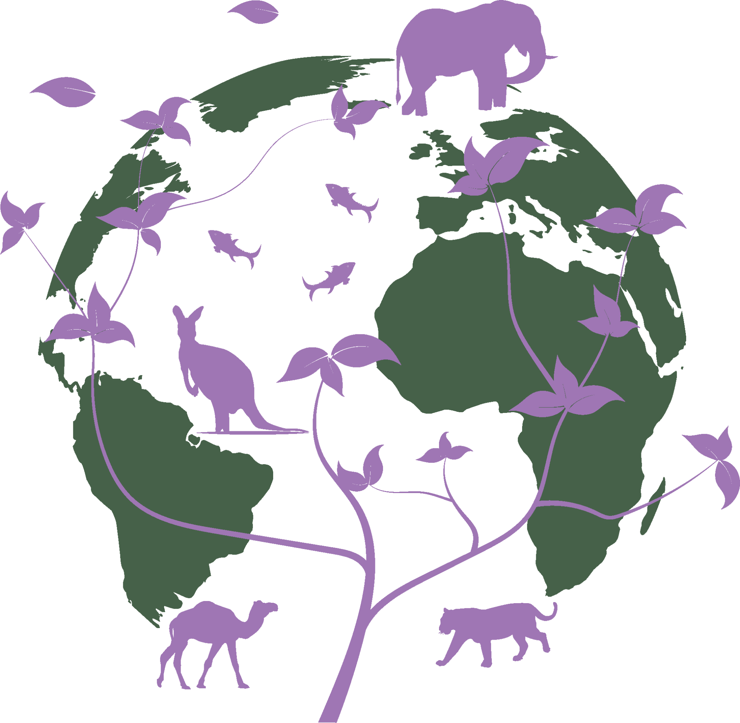
Keyword
Biodiversity = all the different kinds of life you’ll find in one area – the variety of animals, plants and even
micro-organisms like bacteria, that make up our natural world. Each of these species and organisms work together in ecosystems, like an intricate web, to maintain balance and support life

Slide 3

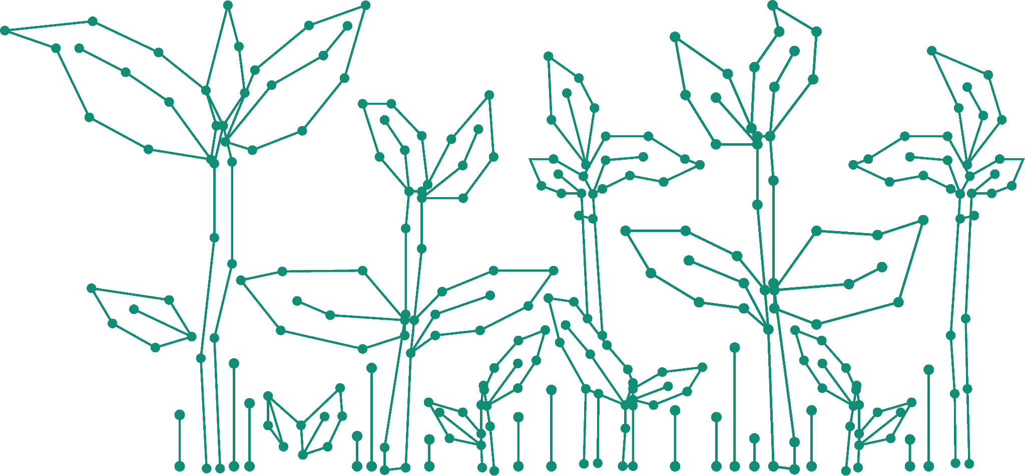
Where does the number go?
People represent just ______% of all living things – but since the dawn of civilisation, humanity has caused the loss of _____% of all wild mammals and half of plants
By one estimate, humans have directly altered at least _____% of Earth's land, mainly for growing plants and keeping animals
Cities account for _____% of all carbon emissions
Today around _____ million animal and plant species are threatened
with extinction

Slide 4
How did you do? Does anything surprise you?
People represent just 0.01% of all living things – but since the dawn of civilisation, humanity has caused the loss of 83% of all wild mammals and half of plants
By one estimate, humans have directly altered at least 70% of Earth's land, mainly for growing plants and keeping animals
Cities account for 75% of all carbon emissions
Today around 1 million animal and plant species are threatened
with extinction

Slide 5


Discuss your group’s questions and be ready to feedback
A
What examples are there of how people might prioritise their needs over nature’s needs?
What might happen if people always prioritise people’s needs over nature’s needs?
B
What examples are there of how people might prioritise nature’s needs over people’s needs?
What might happen if people always prioritise nature’s needs over people’s needs?

Slide 6
Discuss your group’s questions and be ready to feedback
A
You represent people.
A town is getting busier and lots of people want to move there but there is nowhere for them to go.
Families are being split up because there aren’t enough places for everyone to live.
If more people could move into the town, it would help local businesses and bring more money into the area.
B
You represent nature.
A town is getting busier and all of the new people and buildings are having a negative impact on the environment.
Plants and trees have been cut down so that people can build houses and shops.
The wildlife is running out of places to live because the natural spaces that are left are very small.

Slide 7
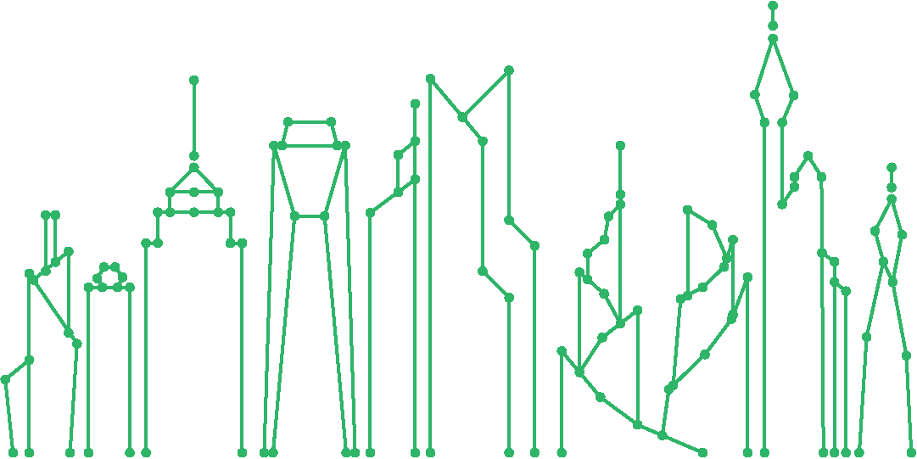



Sometimes it feels like the needs of people and the needs of nature are conflicting (clash).
However, design experts believe that with problem-solving and creativity, it’s possible to come up with solutions that work for everyone.
What solutions can you come up with that would give both people and nature what they need in this situation?

Slide 8
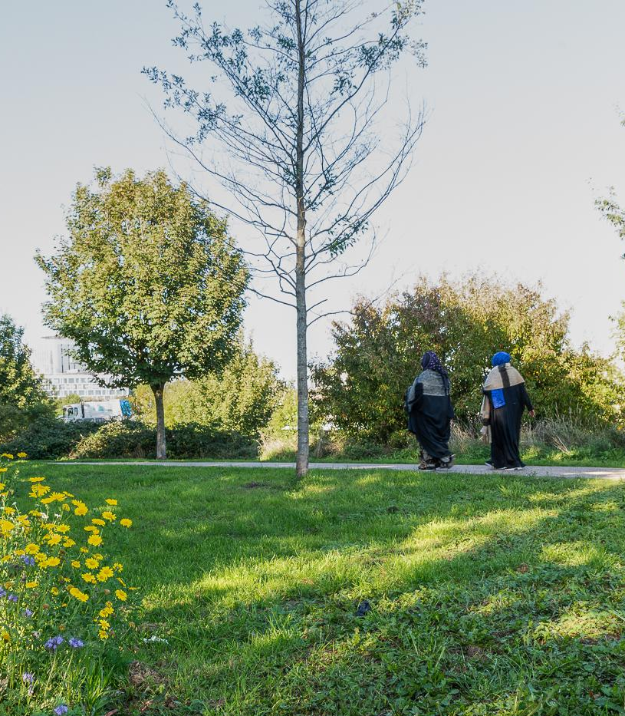
When experts design new towns and cities, they make sure to include green areas, such as parks and urban farms.
These give people a space to enjoy nature and also provide a safe space for wildlife.
Arup

Slide 9
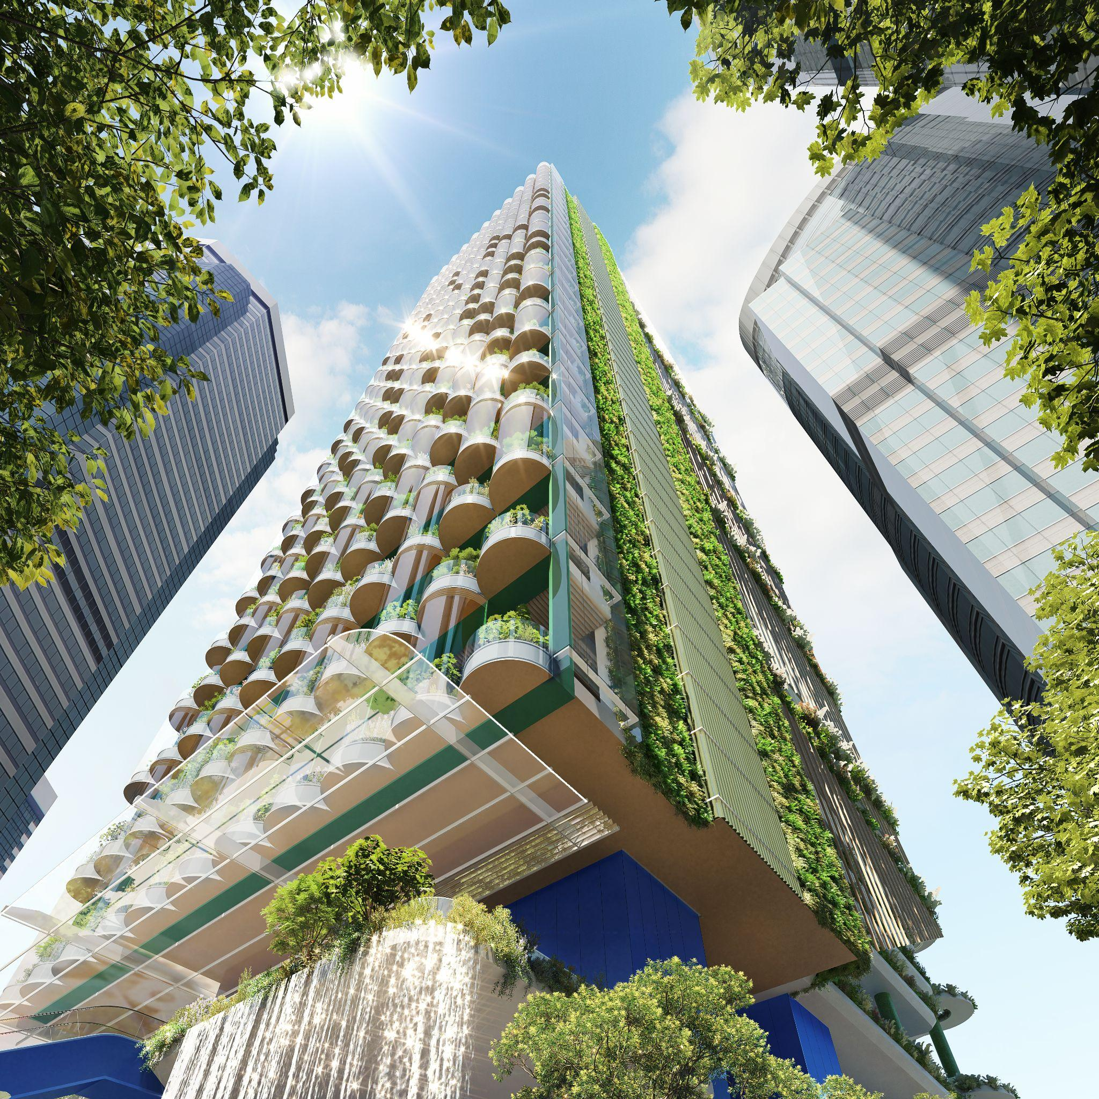
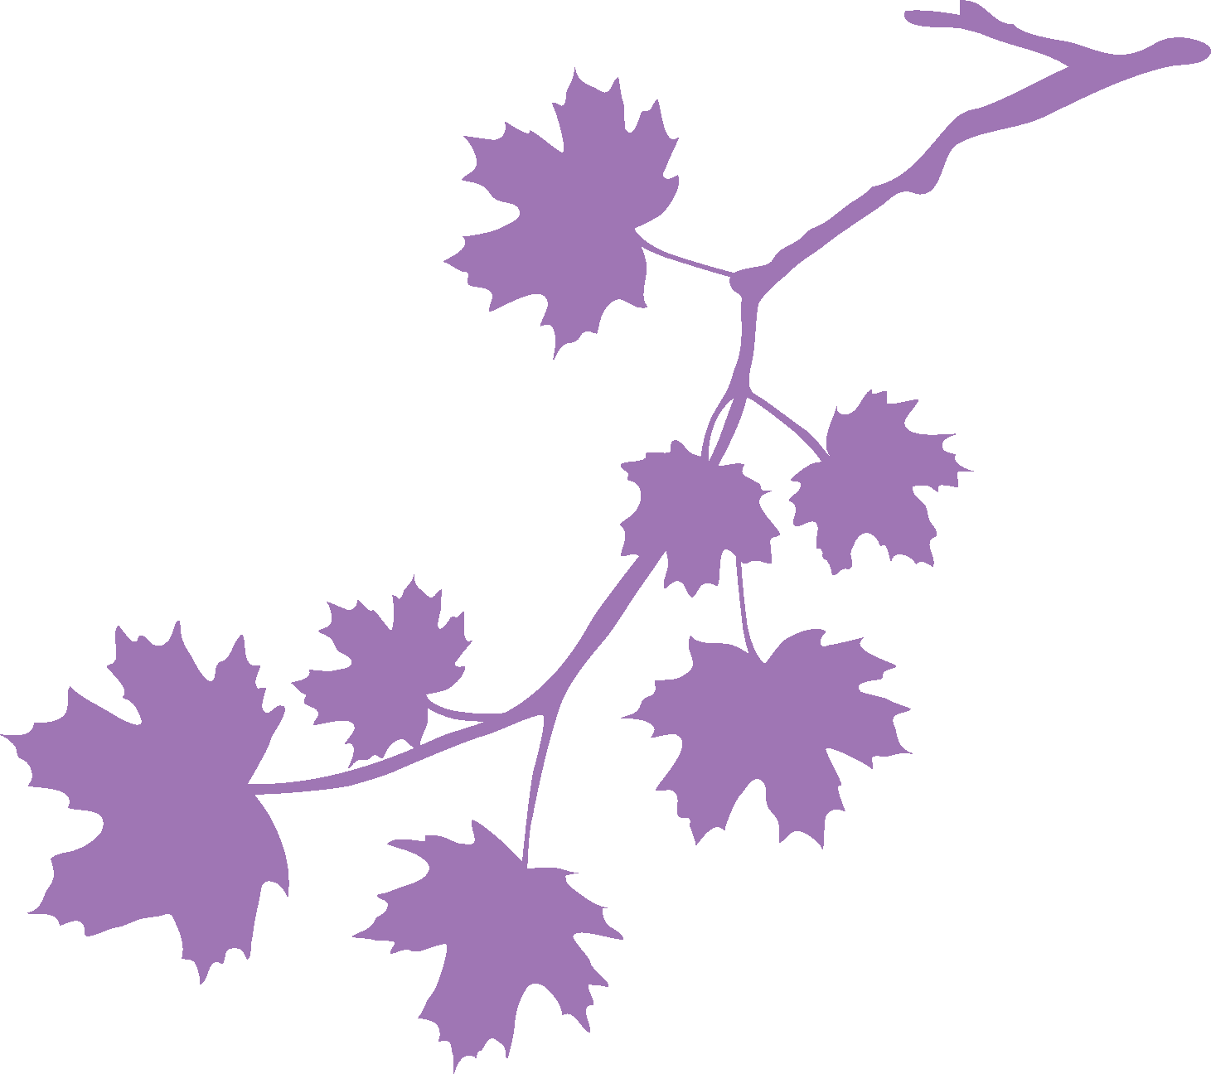
Arup
If it’s difficult to find space for parks and farms, vertical planting can turn buildings into greener spaces.
Building taller buildings also uses less land.

Slide 10
What does your group need?
What should happen next?
A
You represent nature.
A village is very isolated, which means that the surrounding areas are a haven for wildlife.
The animals don’t understand the dangers of roads and train lines because they have never seen them. In other villages, habitats have been destroyed to create roads. Since then, thousands of animals have been killed by vehicles.
B
You represent people.
A village is very isolated – there are no roads or train lines and it can only be reached on foot.
People find it difficult to get everything they need because it is hard to bring things to the village.
Businesses in the village can’t do work with anyone outside because travelling is difficult

Slide 11
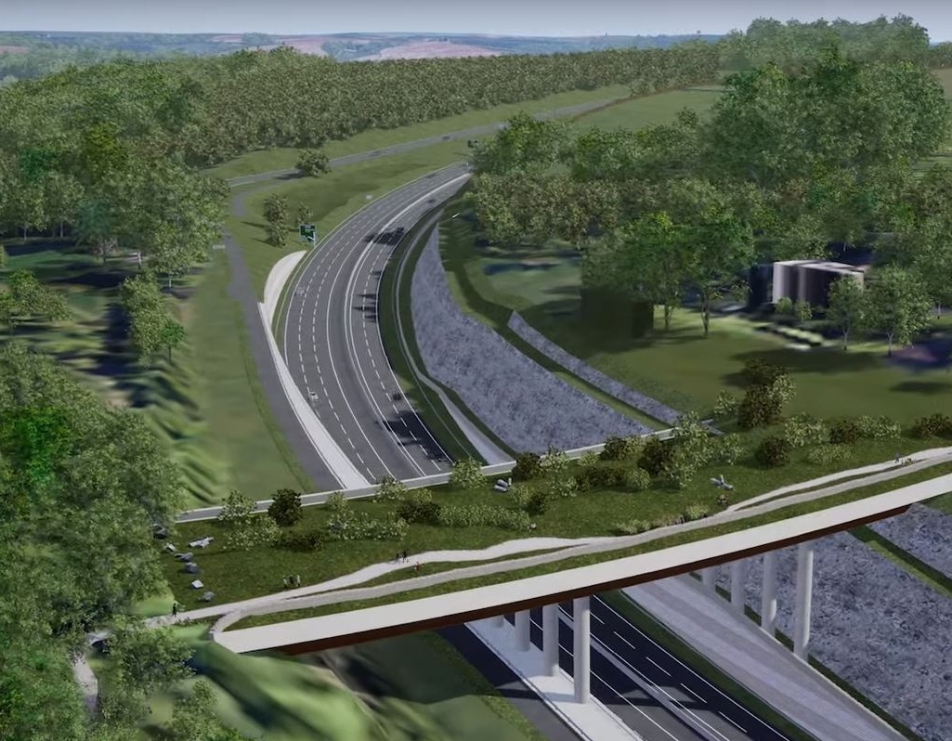
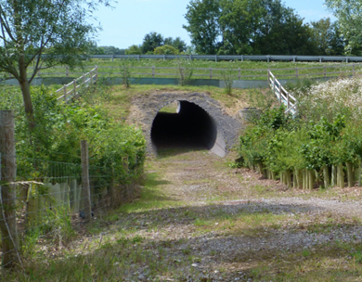
Experts designed “green bridges” and underpasses so that wildlife can cross over or under busy roads safely.
Arup
Arup

Slide 12
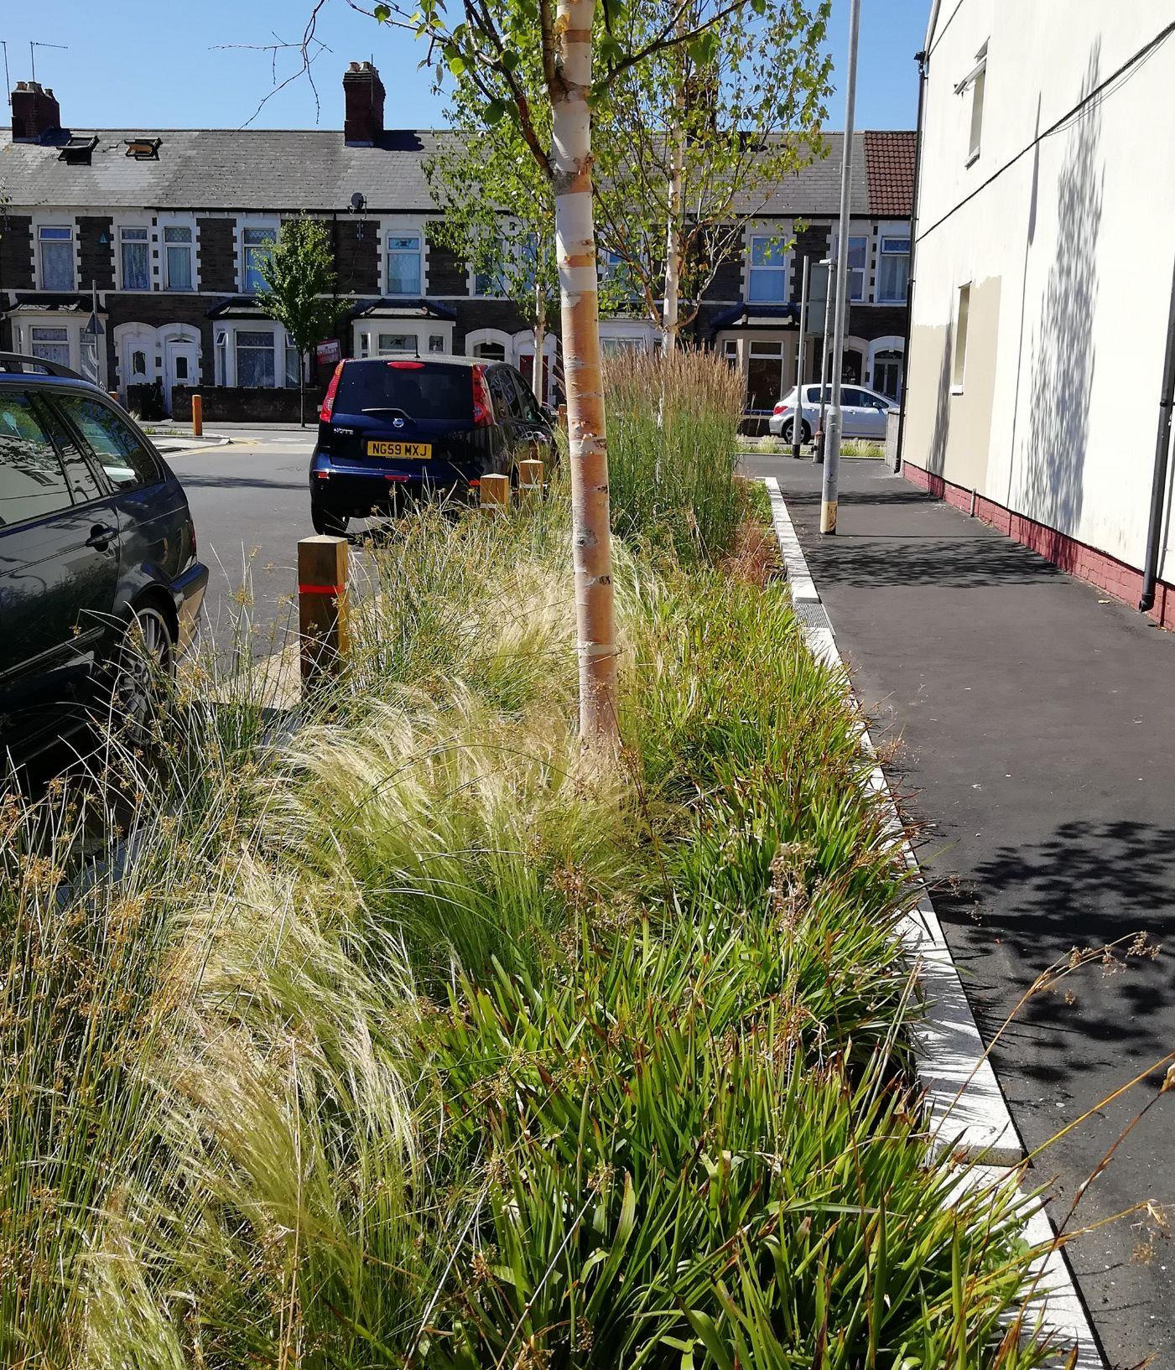
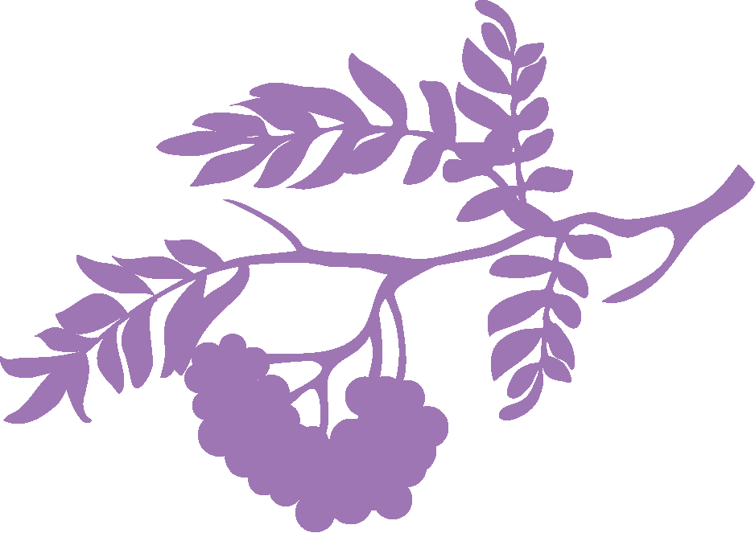
Another solution is planting flowers and trees on verges.
These protect habitats from noise and pollution and also provide a home for small animals and insects.
Arup

Slide 13
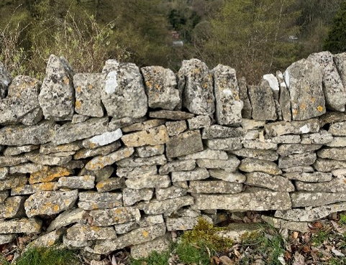
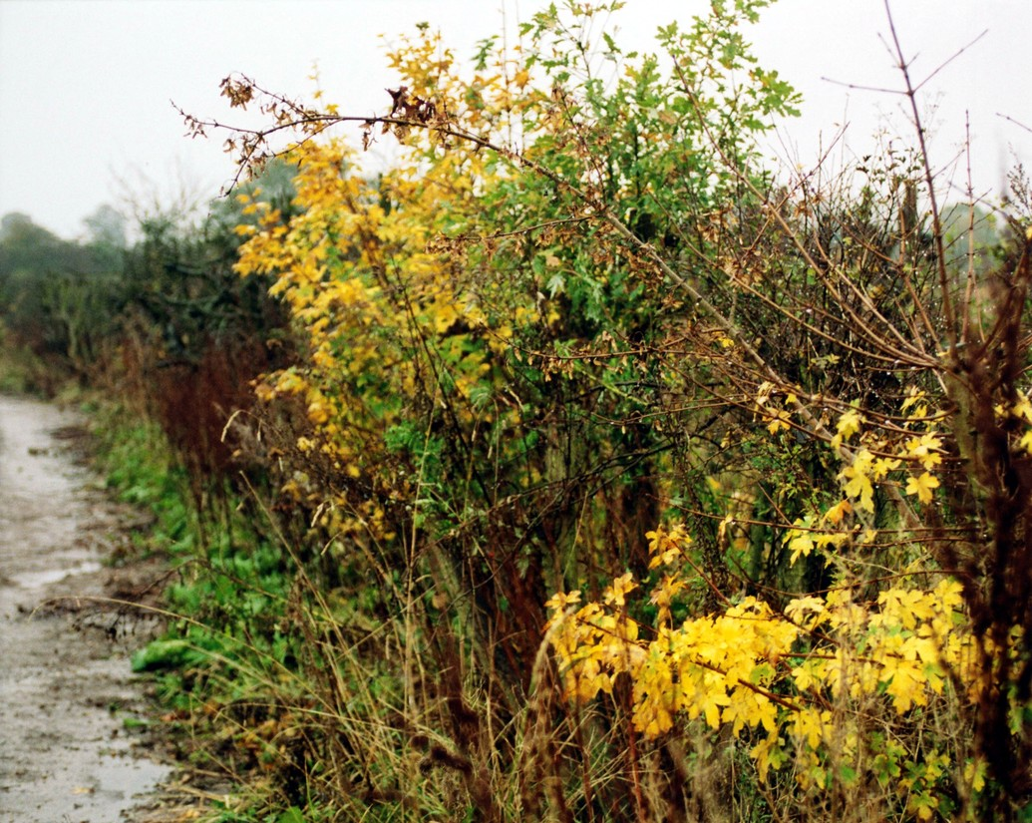
In some areas, people use stone walls or hedgerows along the roadside. They provide boundaries to keep people and animals safe from vehicles – but they also provide a home for animals and insects.
Arup
Arup

