Slide 1











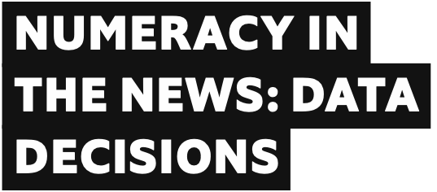



LESSON 1
This resource is part of a Topical Talk Special Edition, produced by The Economist Educational Foundation. Please find the original version of the resource here: bit.ly/42LEZgA

Slide 2
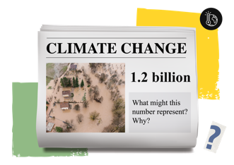
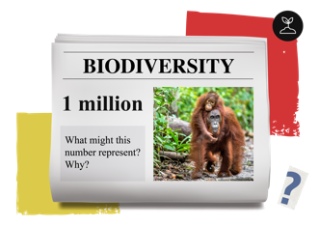

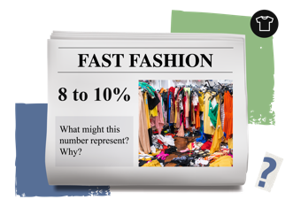
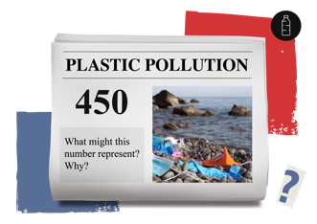
How did you do?
1
3
By 2050 1.2 billion people may be forced out of their homes because of climate change.
Today around 1 million animal and plant species are threatened with extinction.
2
4
8 to 10% of global carbon-dioxide emissions are produced by the fashion industry.
It is estimated that it could take up to 450 years for a disposable face mask to decompose.

Slide 3

Look at your news story and its number.
1
How might people react to this number? For example, how might they feel?
3
Why is it important for people to know this number?
2
How might people respond to this number? For example, what might they do?
4
How easy would it be to understand this news story without numbers?

Slide 4






Sometimes numbers in the news help people to decide how to respond or react to a situation.
Imagine you live in the pretend country of Newsland. You’ve gathered together to listen to the daily radio broadcast of the news.
Click the link below to play the audio – stop when it tells you to pause.
Numeracy in the News: Newsland broadcast

Slide 5


“The numbers in the news I am most interested in are about… because…”

Slide 6

“Numbers in the news are important because…”

Slide 7
“Without numbers, the news would be…because…”

Slide 8
LESSON 2

Slide 9





Keyword
Misleading = when something gives you the wrong idea or impression. If you are misled, you might come to a wrong conclusion or believe information that is not true.
How might you have been misled in this activity? For example, if you all had the same statistic, why might you have had different ideas about whether the news was good or bad? Share ideas together.

Slide 10



Keyword
News literacy = having the critical-thinking skills to evaluate how reliable or credible the news is. For example, being able to spot fake news or misinformation, and realise when you’re being misled or when you’re not getting the full story.
A big part of news literacy is about unpicking the numbers in the news.
During this lesson, you’ll see several examples of how numbers in the news can be misleading.
Be ready to write down your top tips for how to avoid
being misled!

Slide 11
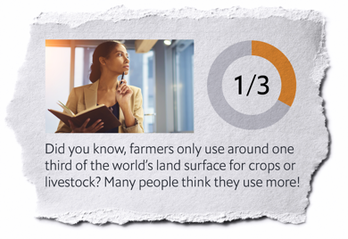
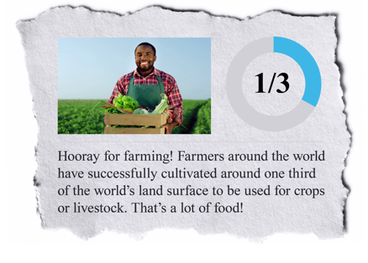
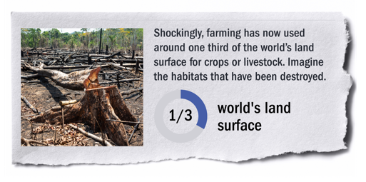
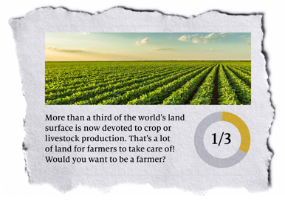
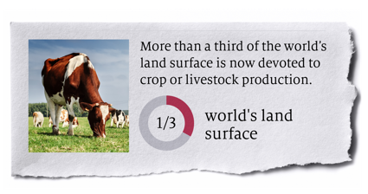
From this example, what top tip would you give people about how to avoid being misled by numbers in the news? Write it on your sheet.
Misleading news: the same statistic
(Note: the United Nations uses this statistic in a report about threats to wildlife)

Slide 12


Misleading news: forced connections
Sometimes people force connections between one thing and another by using the numbers as “evidence”.
For example…

Slide 13
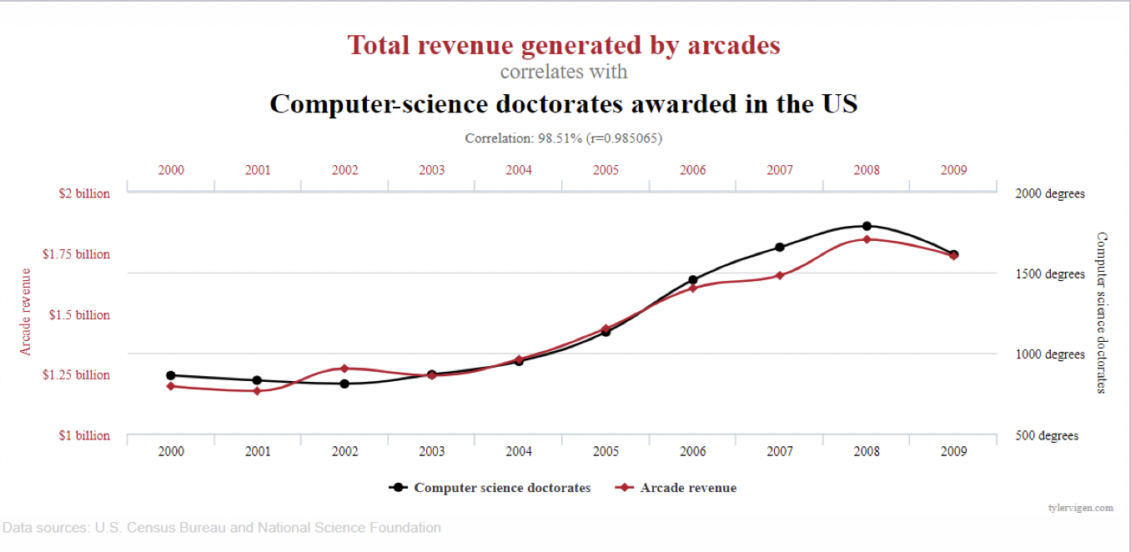
…the red line on this graph shows how much money was spent in arcades from 2000 to 2009. The black line shows data about how many people got computer-science doctorates in the same period.
The graph makes it look like the two things are connected, but actually it is just a coincidence that the lines follow a similar shape.
These graphs are taken from tylervigen.com

Slide 14

What might people think if they saw this graph?
Why might the owner of an arcade share this graph?
These graphs are taken from tylervigen.com

Slide 15
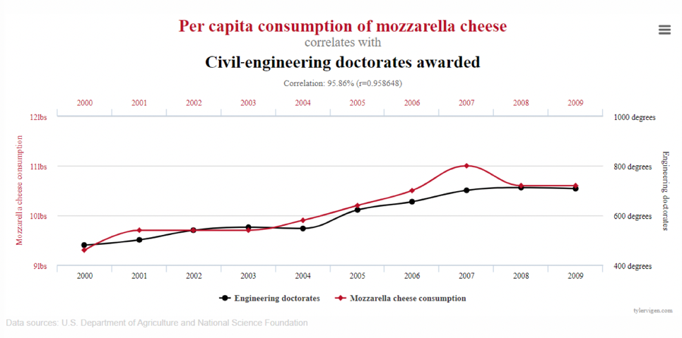
Similarly, this graph seems to show a connection between people who eat mozzarella cheese and people who get a doctorate in civil-engineering. In reality, there is no connection. But who might want to share this graph anyway? Why?
Just because two data sets have similar patterns does not mean that people should make an assumption that one thing is connected to (or causes) another. This can lead to misinformation.
These graphs are taken from tylervigen.com

Slide 16




Misleading news: bad evidence
Sometimes people use numbers in the news as evidence to support their argument.
However, people do not always use numbers correctly and this means they can come to wrong conclusions.
For example…

Slide 17



...look at this.
A shopkeeper stocks apples and bananas, which are ordered from abroad.
By the time the fruit arrives at the shop to be sold, some fruit is always mouldy.
Usually 10% of the mouldy fruit is apples and 90% of the mouldy fruit is bananas
Which fruit is more likely to be mouldy by the time it arrives at the shop? What advice would you give
to the shopkeeper?

Slide 18
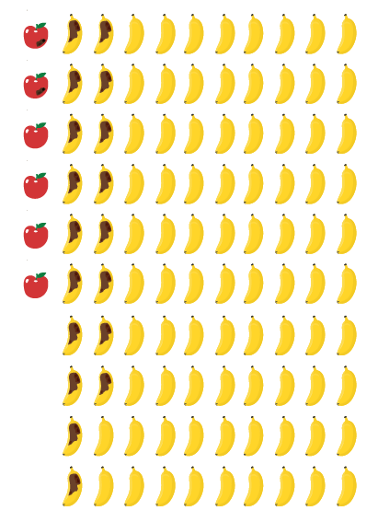

But wait…
The shopkeeper usually orders 100 bananas and 6 apples.
Of those, 20 pieces of fruit are
usually mouldy.
Look at the picture for what this means
for the numbers of mouldy fruit.
Which fruit is more likely to be mouldy by the time it arrives at the shop? Has your advice to the shopkeeper changed?

Slide 19
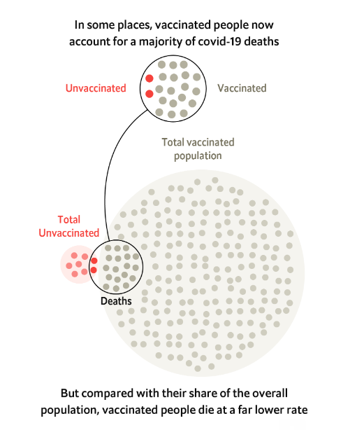
Sometimes, if people don’t understand the numbers, it can mean they make wrong decisions or give bad advice.
A real example of this was seen during the covid-19 pandemic. Because there are now many more people who are vaccinated against covid-19 than unvaccinated people, in some places, vaccinated people account for a majority of covid-19 deaths.
Some people used these numbers to wrongly say that vaccinations don’t work. When we look at the bigger picture, it is clear that they do.

Slide 20



Misleading news: part of a story
Sometimes people jump to conclusions without looking at enough information.
For example…

Slide 21
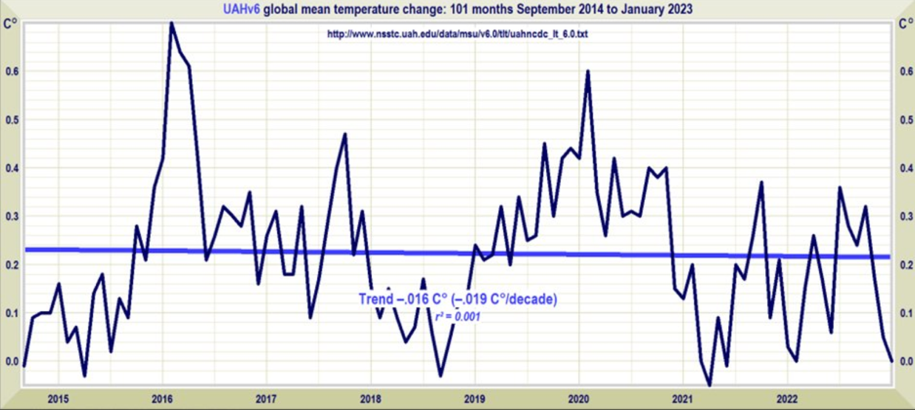
This graph shows NASA data about the global mean temperature changes from 2015 to 2022. It shows that global temperatures have risen and fallen but on average remained consistent (shown by the thick blue line).

Slide 22
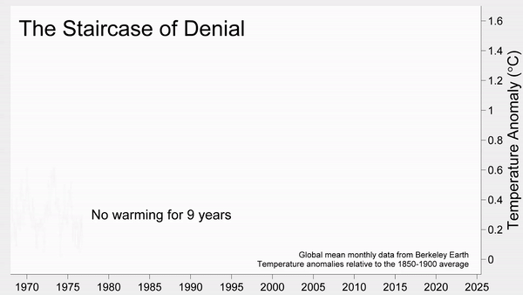


What does this show about global temperatures? What if you only saw part of it?
The previous graph is a small part of this one. It shares much more data. Look at the blue lines in this graph.

Slide 23




Misleading news: perspectives
Sometimes people feel differently about a piece of news depending on their perspective.
For example…

Slide 24
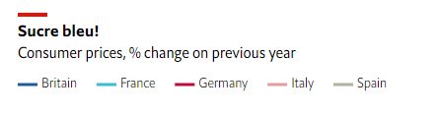
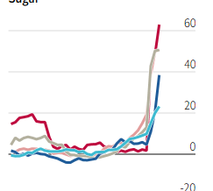
…look at this graph.
It shows that the cost of sugar
is increasing.
How might your character feel about this?
Does it show good news or bad news?
The Economist

Slide 25


Marie Segger is a data journalist at The Economist newspaper.
As you listen to her top tips, tick the things on your sheet that she mentions. Add any new ideas onto the back of your sheet.
Marie Segger:
Data Journalist

Slide 26
LESSON 3

Slide 27


Keyword
Data = information in the form of text, observations, figures, images, numbers, graphs, or symbols. For example, numbers and isolated facts. Data is a raw form of knowledge and, on its own, doesn't carry any significance or purpose.
A group of data about the same topic is called a data set.
Journalists put data together to form a picture about things that are happening in the news – a bit like a jigsaw puzzle
of information.

Slide 28


Sarah Leo is a visual data journalist at The Economist newspaper.
A = what does a good visual data journalist do?
B = what tips does Sarah have for choosing which data to present?
C = what tips does Sarah have for presenting data clearly?
Sarah Leo:
Data Visualiser
Notes:
Picture of Sarah (can be found in the KPMG workshop ppt)

Slide 29
What data did you include? What data didn’t you include? Why?
What presentation did you choose and why? For example, why is your chart or graph the clearest way?
What do you hope people will learn from your data?
Do you have any concerns about the way you have presented your data?

Slide 30
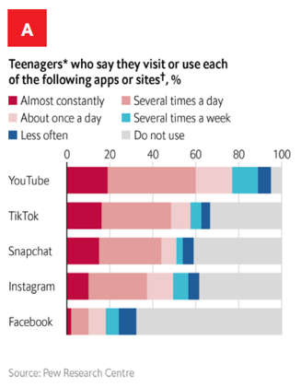
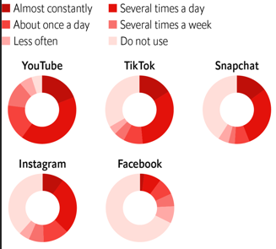
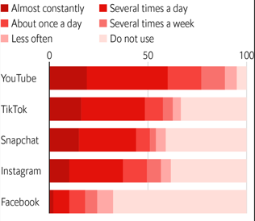
Look at charts A, B and C. Which do you think journalists
at The Economist chose to use? Why?
A
B
C
Social media platforms
Teenagers spend a lot of time on social media

Slide 31
LESSON 4

Slide 32

Why are numbers in the news important?

Slide 33
Why is the way that data is presented important?

Slide 34
How might data in the news be misleading?

Slide 35
What questions can you ask yourself to avoid being misled by data in the news?

Slide 36






Do teenagers spend too much time on social media?
What does the data on the card tell you?
What doesn’t the data on this card tell you?
Is this data reliable? Why or why not?
Does this data argue for “yes” or for “no”?
Don’t forget to use your top tips from Lesson one to help you interpret the numbers.
Finished early? Order your data from “most convincing argument” to “least convincing argument”.

Slide 37


Do teenagers spend too much time on social media?
Team A = argue for “yes”
Team B = argue for “no”

Slide 38
Do teenagers spend too much time on social media?
Is there anything more you’d like to know before you make a firm decision?
What new data might change your mind?

Slide 39
LESSON 5 & 6

Slide 40






What is a Standpoint?
A Standpoint is your final say on a topic. It gives you a chance to share your opinion, in audio, film or writing.

Slide 41
Standpoint prompts
Why is it important to use data as evidence to support your arguments?
How do you know that you have not been misled by your data?
What data might support the opposite side of the argument? Why is your data more convincing?

Slide 42





Skills and knowledge reflections
Think about your learning from every lesson in this Special Edition.
When have you…
1. …spoken engagingly by using facts and examples to support
your points?
2. …listened critically and thought about where differences in perspectives come from?
3. …explored problems by using logical numerical reasoning?
4. …developed ideas by using mind mapping?
5. …explained how historical and cultural context affects
people’s opinions about data?

