Slide 1

Why AI Will Never Replace Humans
Marathon Greece
July 2025
Dr. Daithí Ó Murchú
https://synapses-academies.eu/
Funded by the European Union. Views and opinions expressed are however those of the author(s) only and do not necessarily reflect those of the European Union or the European Education and Culture Executive Agency (EACEA). Neither the European Union nor EACEA can be held responsible for them.

Slide 2


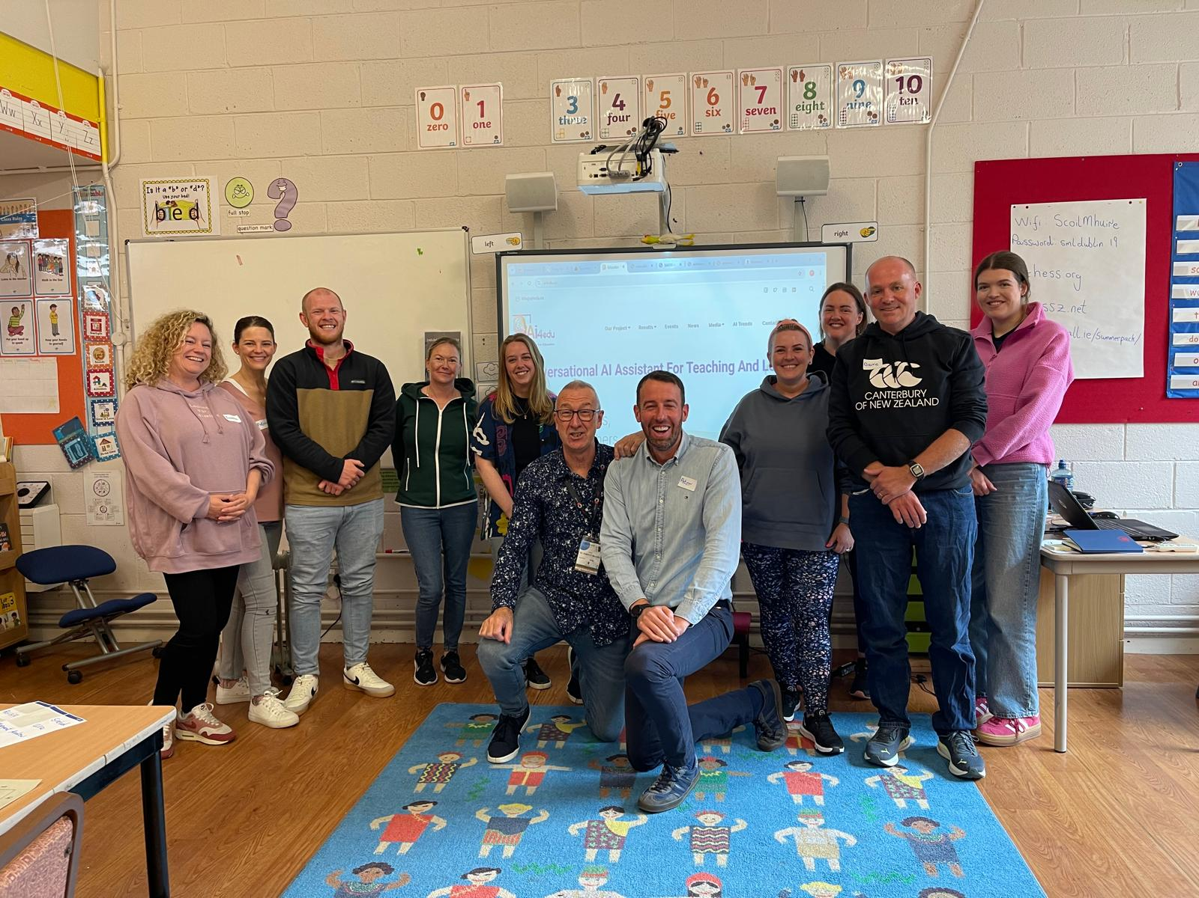
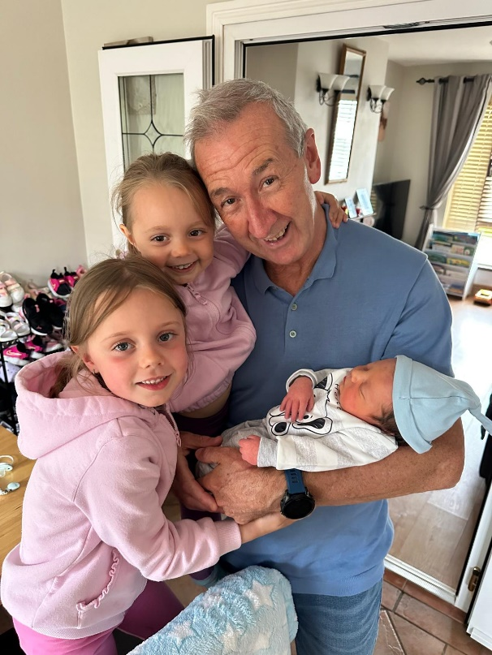


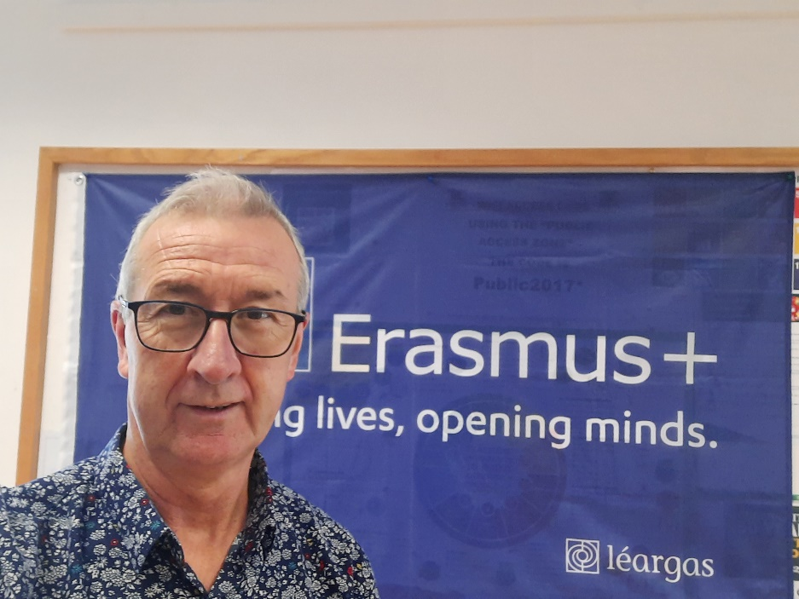

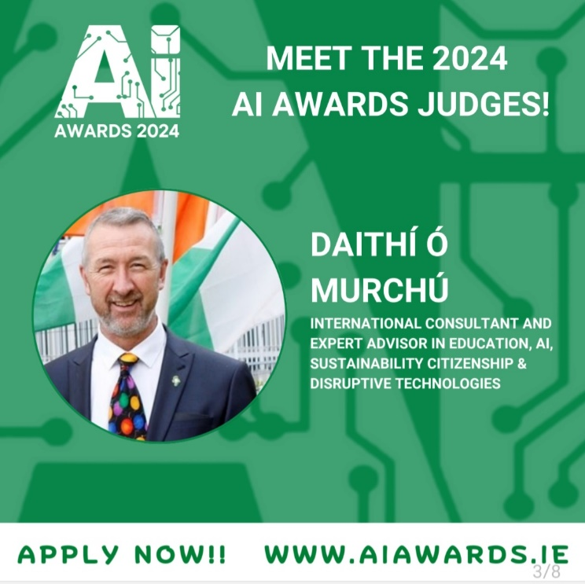



Me….. Human Being

Slide 3
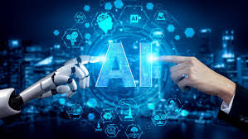
Built‑in Limits of Current AI
No true creativity – only pattern remixing
Lacks emotional intelligence and empathy
Shallow contextual understanding & cultural nuance

Slide 4
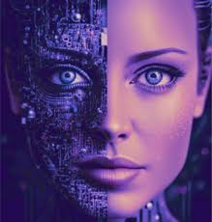
Irreplaceable Human Strengths
Adaptive, cross‑domain problem‑solving
Ethical judgement and moral agency
Creativity and meaning‑making in arts & science

Slide 5
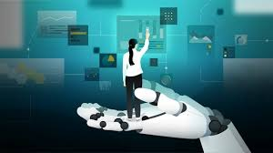
Augmented Intelligence: Collaboration Model
AI automates data‑heavy micro‑tasks
Humans provide insight, relationships & strategy
"Centaur" teams outperform AI or working solo

Slide 6
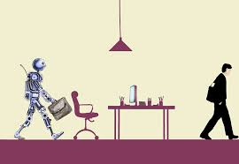
Jobs & Education: Transformation, Not Elimination
Secure roles: teaching, counselling, law, creative arts
Emerging roles: AI‑fluent curriculum design, model auditing
Teach critical thinking, digital literacy, socio‑emotional skills

Slide 7

Governance & Trust
Embed fairness metrics & adversarial testing
Maintain human oversight in every deployment
Align AI use with institutional values & learner wellbeing

Slide 8

Key Takeaways
AI is powerful but narrow: lacks creativity, empathy, ethics
Human strengths remain non‑automatable & indispensable
Synergy – not substitution – will unlock the greatest value

Slide 9
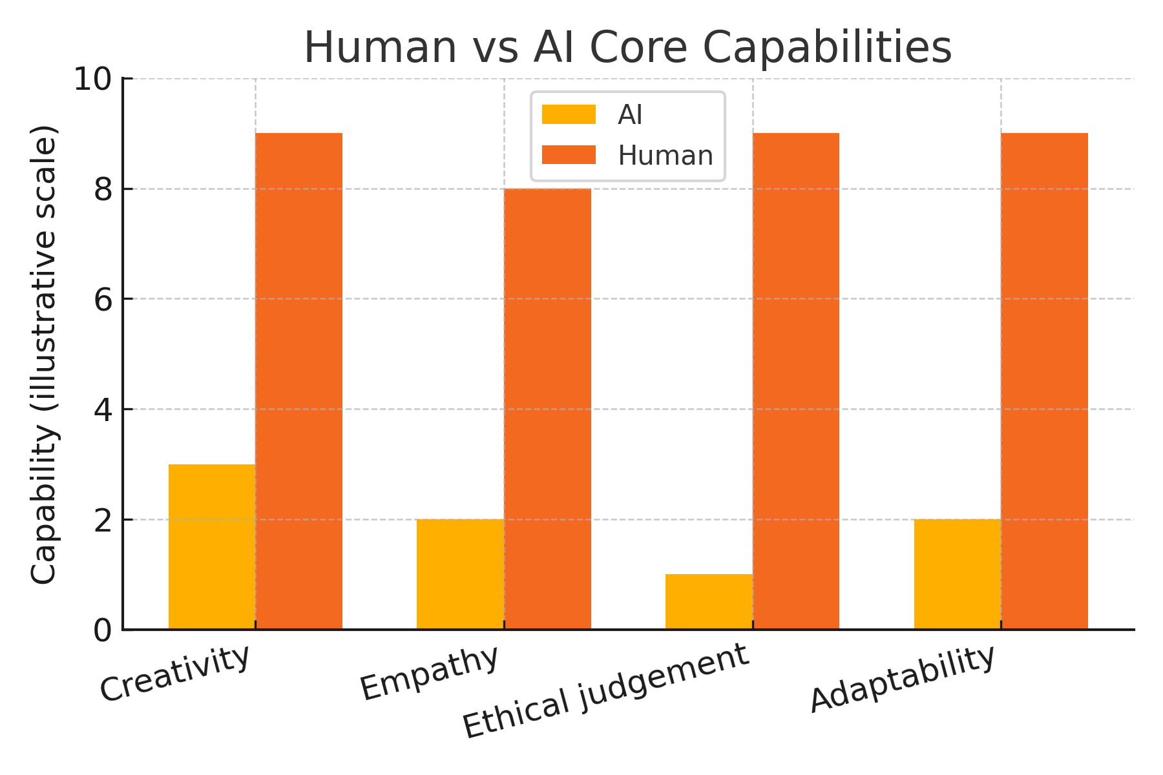
Visual: Human vs AI Capabilities

Slide 10
References
De Cremer, D. and Kasparov, G. (2021) ‘‘AI Should Augment Human Intelligence, Not Replace It’’, Harvard Business Review, 18 March. Available at: <https://hbr.org/2021/03/ai-should-augment-human-intelligence-not-replace-it> (Accessed: 11 May 2025).
Marr, B. (2024) ‘‘AI Won't Replace Humans – Here's the Surprising Reason Why’’, Forbes, 28 November. Available at: <https://www.forbes.com/sites/bernardmarr/2024/11/28/ai-wont-replace-humans--heres-the-surprising-reason-why/> (Accessed: 11 May 2025).
Maryville University (2024) ‘‘Artificial Intelligence vs. Human Intelligence’’, Maryville Online Blog, 6 June. Available at: <https://online.maryville.edu/blog/ai-vs-human-intelligence/> (Accessed: 11 May 2025).
University of Auckland (2023) ‘‘The limits of Artificial Intelligence and why it matters’’, University of Auckland News, 23 May. Available at: <https://www.auckland.ac.nz/en/news/2023/05/23/limits-of-ai-and-why-it-matters.html> (Accessed: 11 May 2025).
Amdur, E. (2023) ‘‘Jobs AI Just Can't Do’’, Forbes, 25 November. Available at: <https://www.forbes.com/sites/eliamdur/2023/11/25/jobs-ai-just-cant-do/> (Accessed: 11 May 2025).
Forbes Business Council (2024) ‘‘Understanding the Limits of AI and What This Means for Cybersecurity’’, Forbes, 29 February. Available at: <https://www.forbes.com/councils/forbesbusinesscouncil/2024/02/29/understanding-the-limits-of-ai-and-what-this-means-for-cybersecurity/> (Accessed: 11 May 2025).
Marks, G. (2025) ‘‘Yes, AI will eventually replace some workers. But that day is still a long way off’’, The Guardian, 11 May. Available at: <https://www.theguardian.com/business/2025/may/11/artificial-intelligence-small-business> (Accessed: 11 May 2025).

Slide 11
Why AI Will Never Replace Humans
Marathon Greece
July 2025
Dr. Daithí Ó Murchú
https://synapses-academies.eu/
Funded by the European Union. Views and opinions expressed are however those of the author(s) only and do not necessarily reflect those of the European Union or the European Education and Culture Executive Agency (EACEA). Neither the European Union nor EACEA can be held responsible for them.

