Slide 1

Title of the
Green Action Plan
School Head Name
School Name
Educational Level
Funded by the European Union. Views and opinions expressed are however those of the author(s) only and do not necessarily reflect those of the European Union or the European Education and Culture Executive Agency (EACEA). Neither the European Union nor EACEA can be held responsible for them.

Slide 2

My vision for a sustainable school is…
Formulate your vision here
Remember that your goals should be linked with Sustainability Citizenship.

Slide 3
My Green Action Plan, formulated SMART:
Specific
Make the goal clear and focused by defining exactly what you want to achieve.
→ Instead of "improve education," say "integrate soil education into the science curriculum for Year 5 students."
Measurable
Include a way to track progress or know when the goal is achieved.
→ Add a metric, like "by developing three lesson plans and piloting them in two schools."
Icons of the Sustainable Development Goals can be found in slide 5

Slide 4
My Green Action Plan, formulated SMART:
Achievable
Ensure the goal is realistic and attainable given the time, resources, and context.
→ Aim for something doable, such as "train 10 teachers in soil education methods over the next 6 months."
Realistic
Align the goal with broader priorities or needs to ensure it matters.
→ Link it to your mission, e.g., "this supports our school’s sustainability vision and outdoor learning strategy."
Time-bound
Set a clear deadline to create urgency and focus.
→ Include a timeframe like "by the end of the current school year" or "within three months."
Icons of the Sustainable Development Goals can be found in slide 5

Slide 5






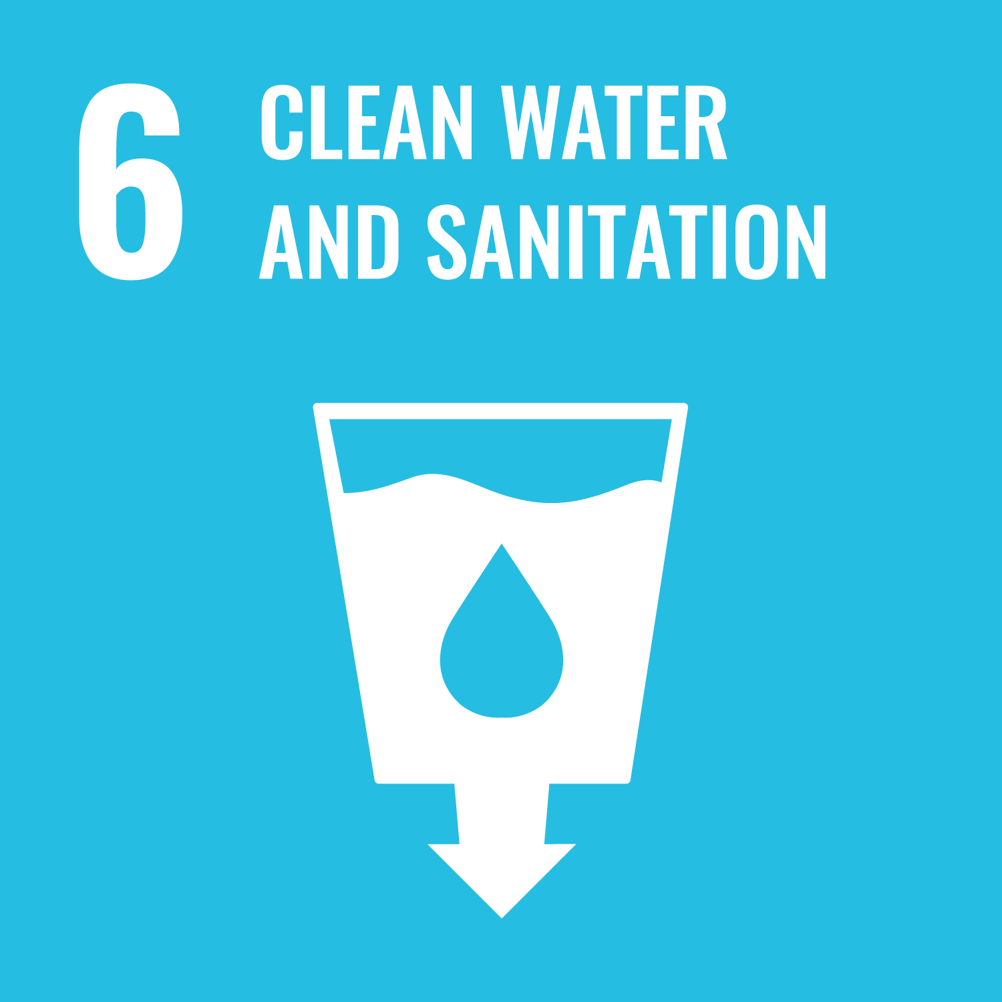
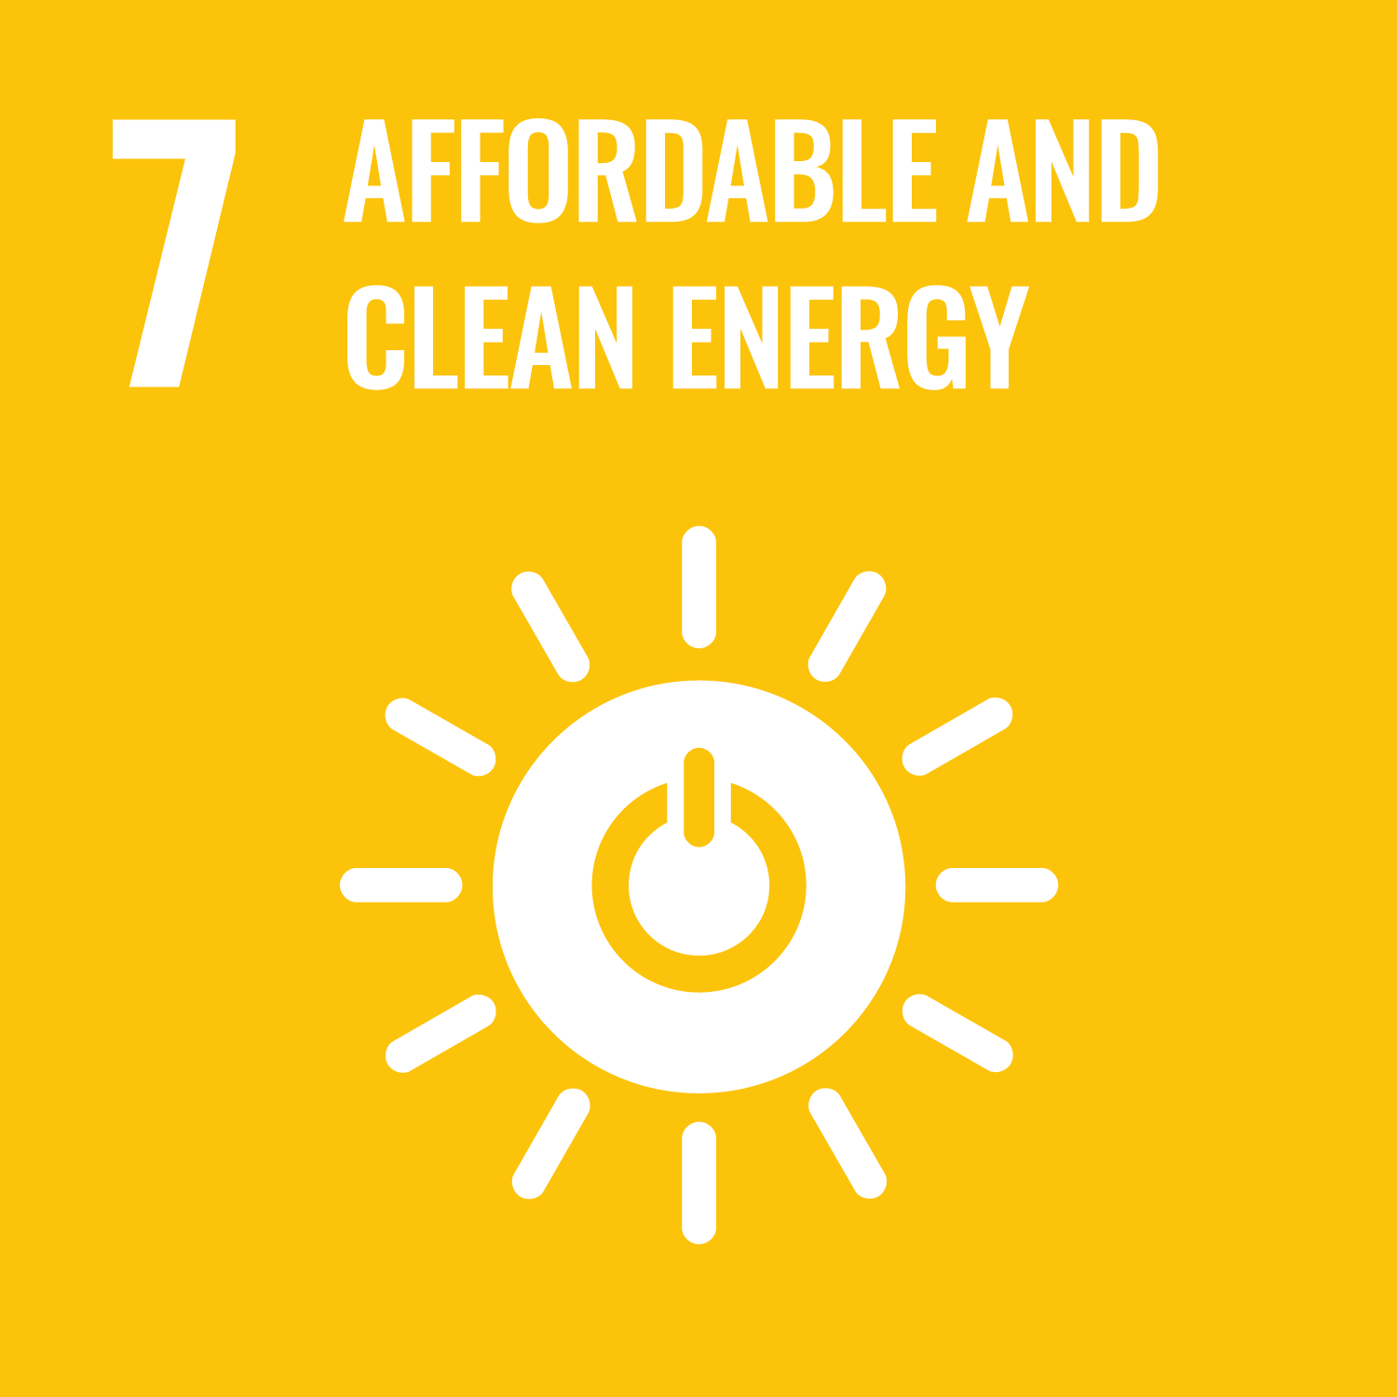





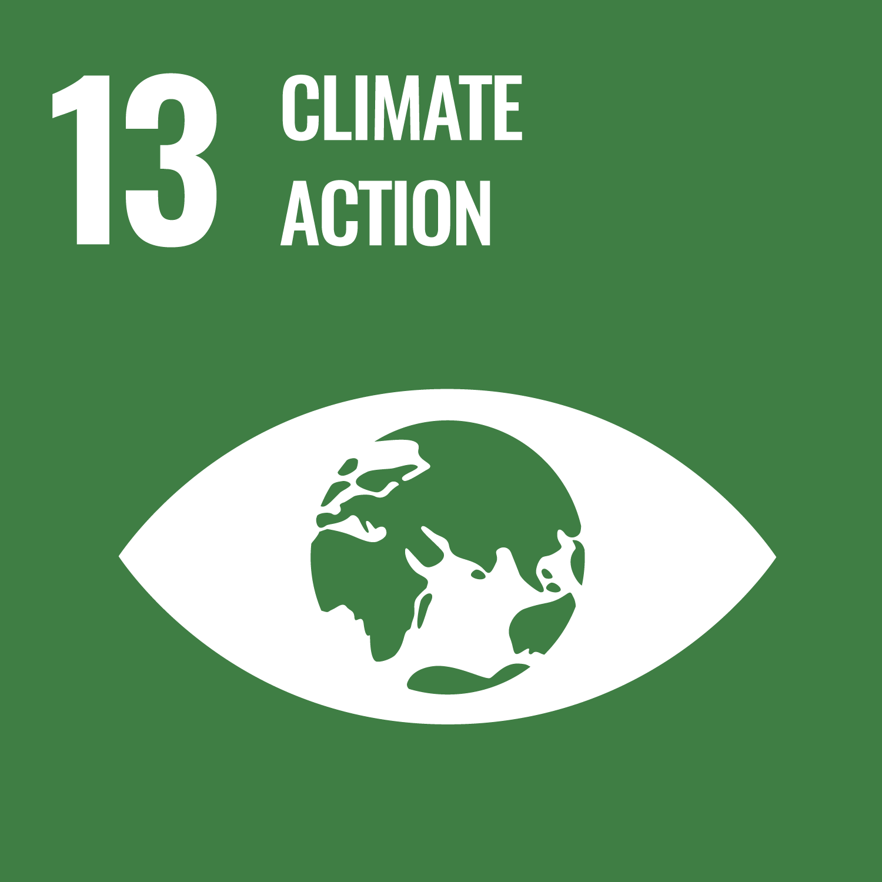
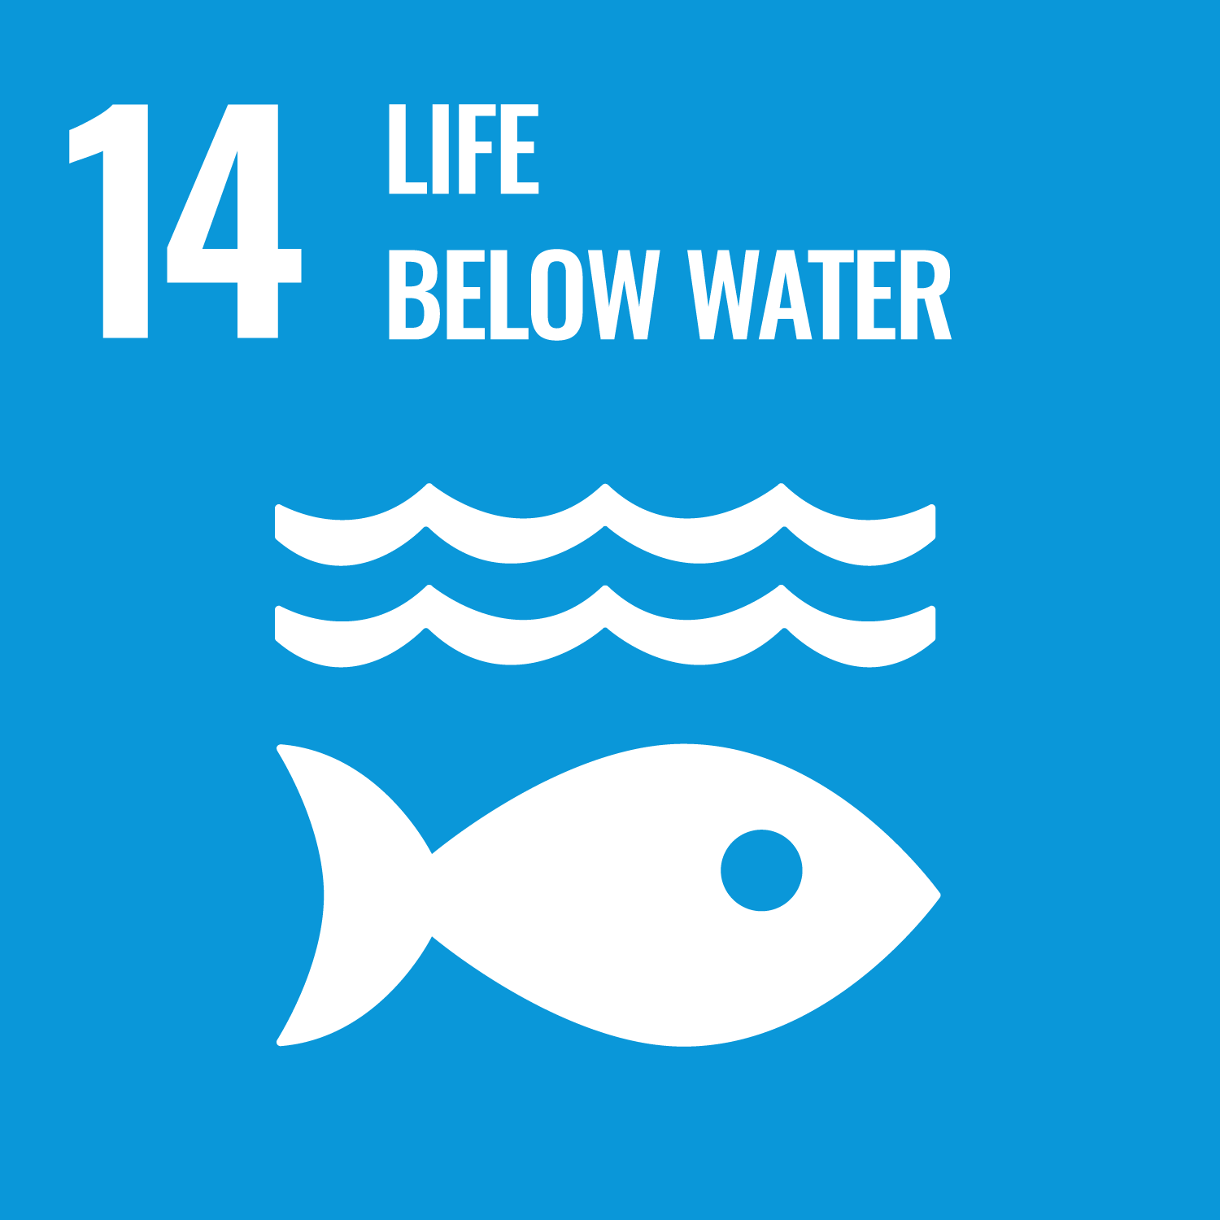
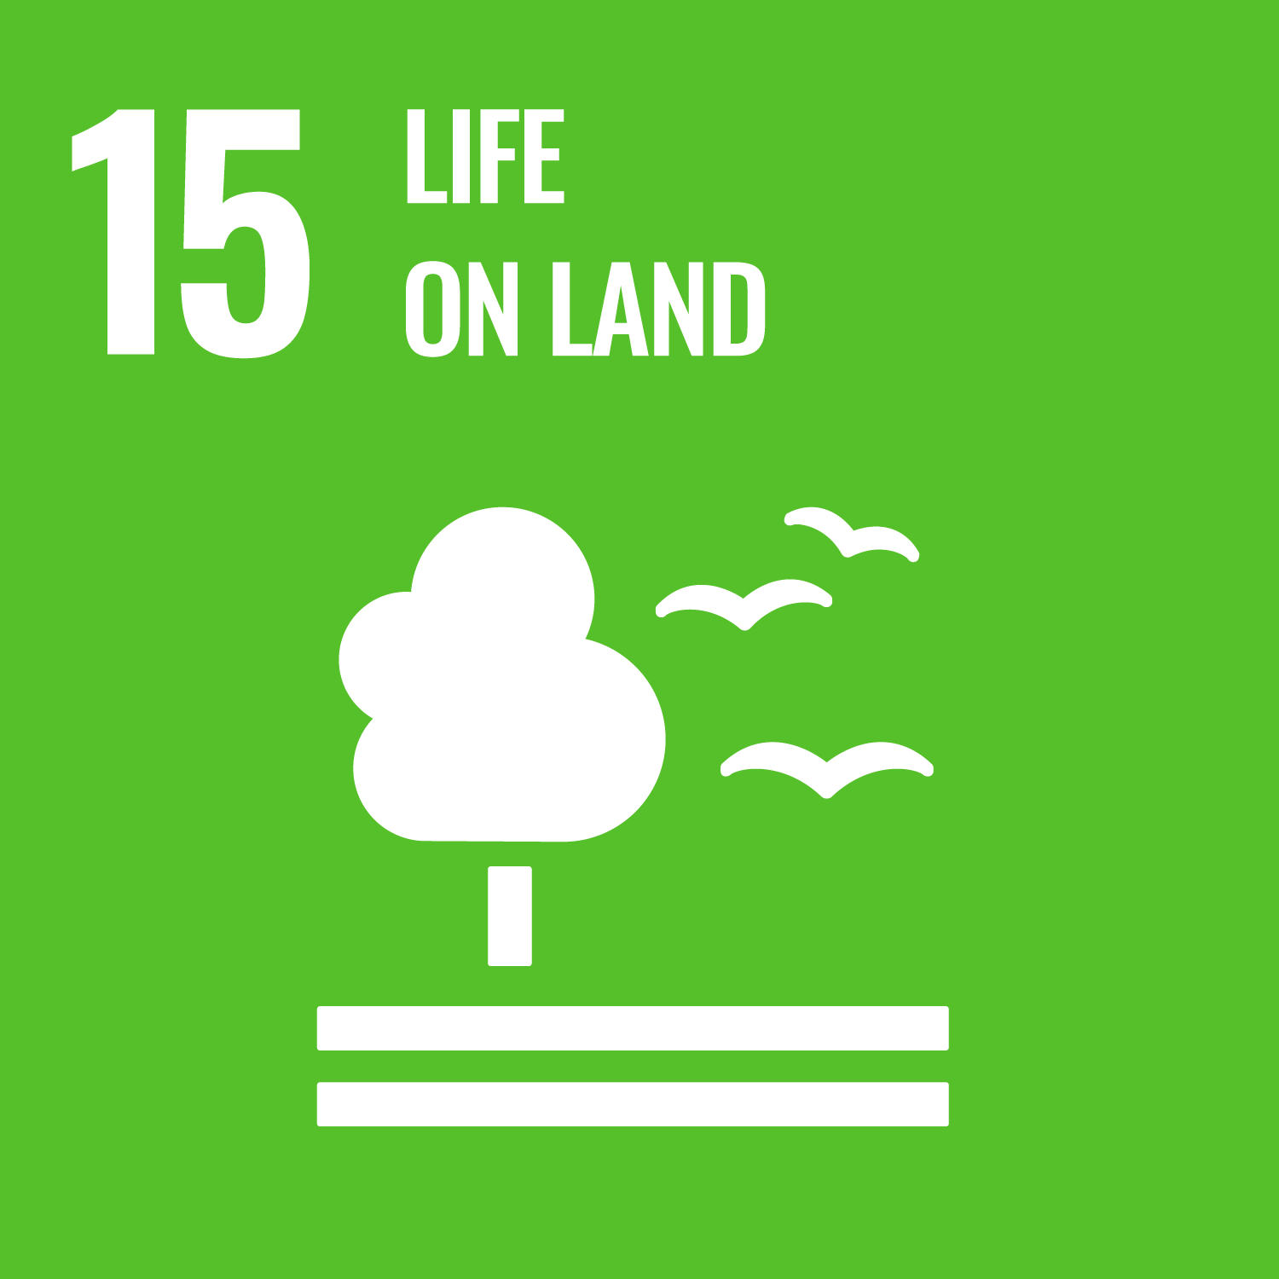


This plan links to the Sustainable Development Goals:
Select the goals you want and delete the remaining icons

