Slide 1
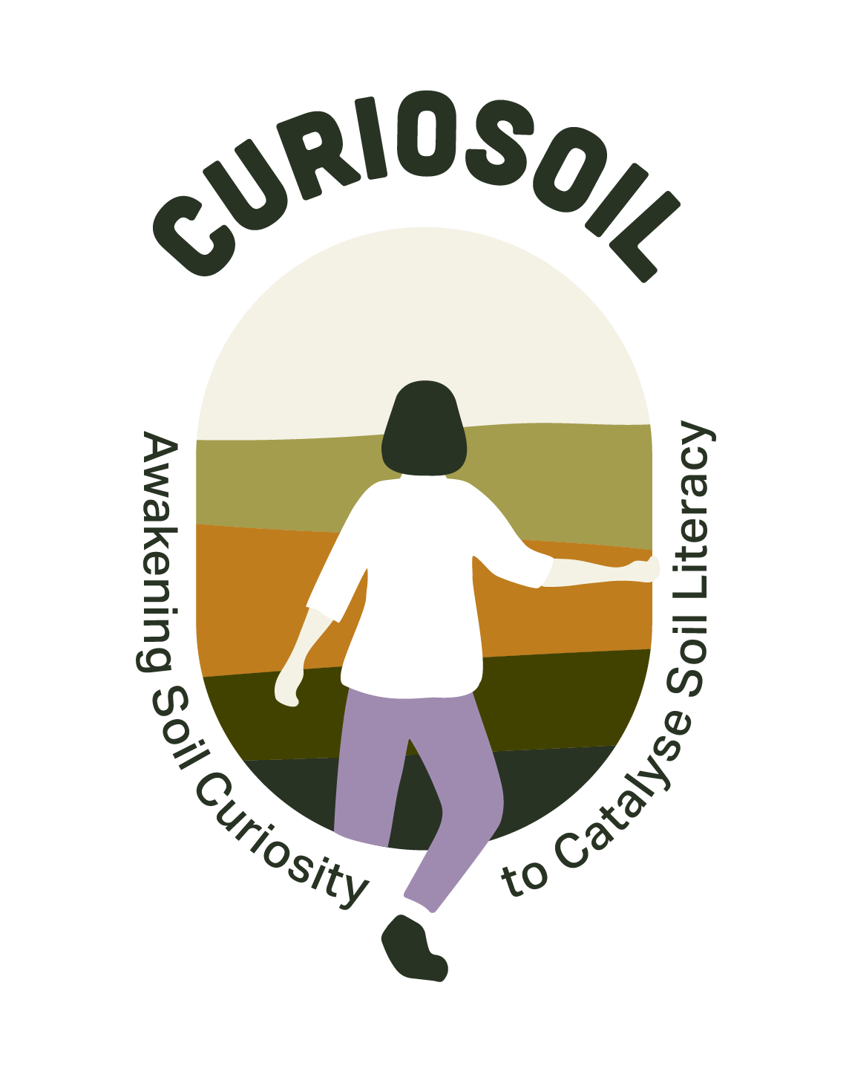
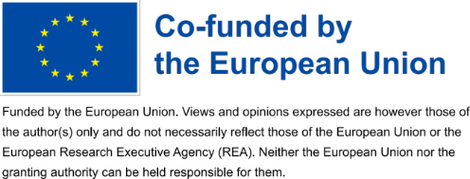
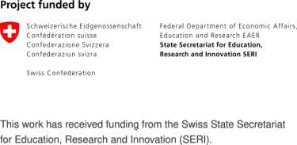
Awakening Soil Curiosity to Catalyse Soil Literacy
The 5Ws of CURIOSOIL
& Meaningful implementation

Slide 2
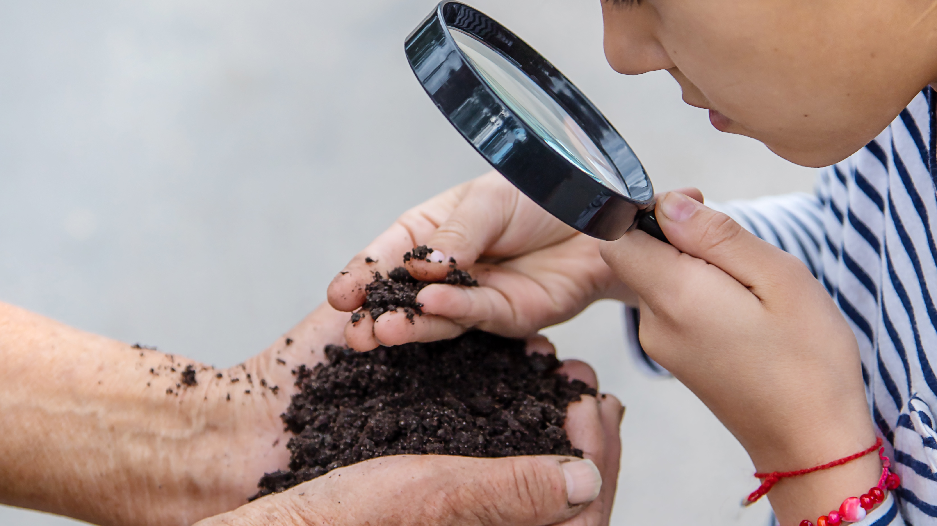
What is CURIOSOIL?
CURIOSOIL (Awakening Soil Curiosity to Catalyse Soil Literacy) is a four-year EU co-funded project focused on enhancing soil education. Led by Universidade de Aveiro, the project addresses the critical need for a better understanding of soil amid increasing human pressures on this essential resource.
Using hands-on Soil Experiences, CURIOSOIL aims to deepen public comprehension of soil dynamics, establishing a connection between individuals and soil.

Slide 3


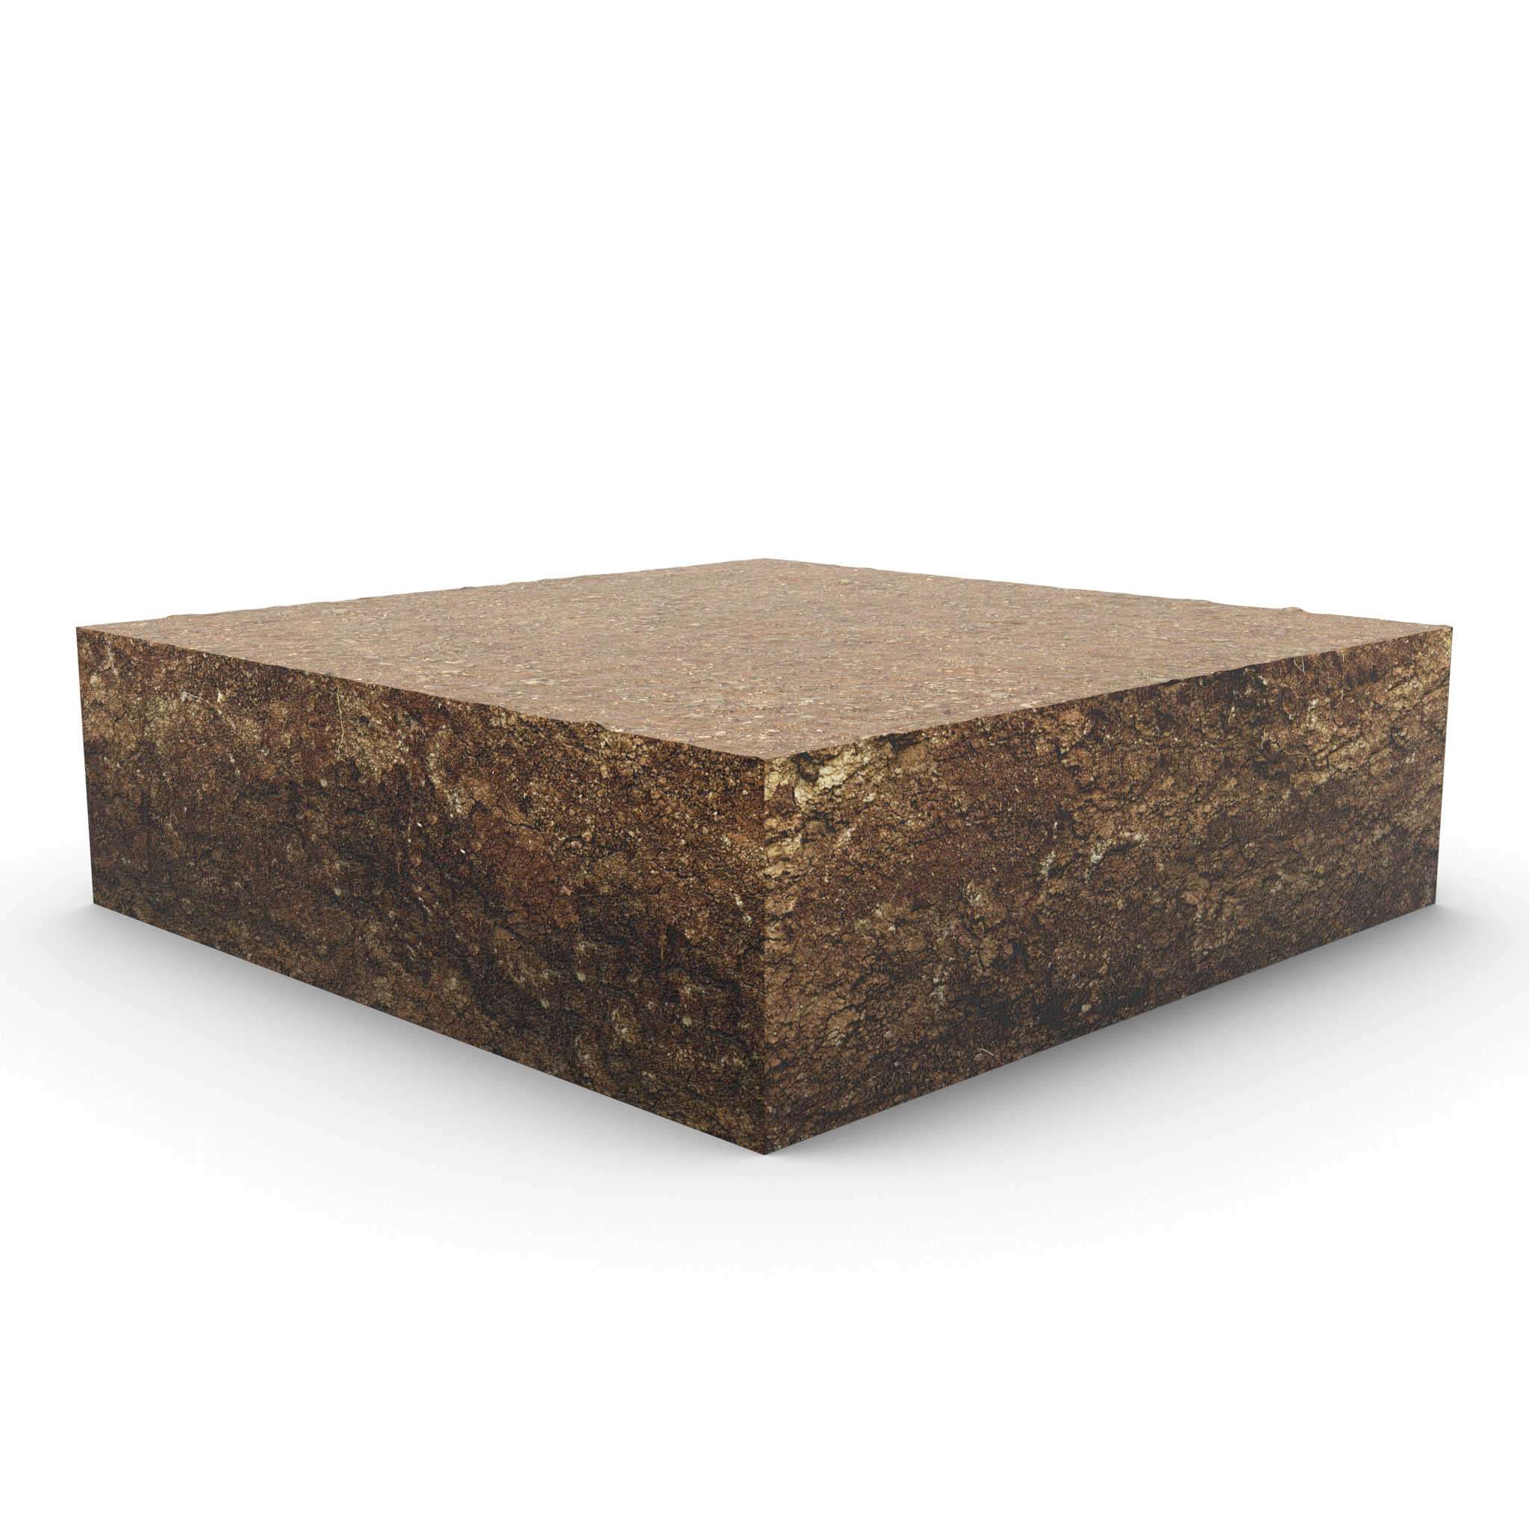

Why CURIOSOIL?
Soil health is essential for life on Earth, but more than 60% of soil ecosystems in Europe are at risk of degradation.
The project aims to address gaps in the understanding of soil health among students, teachers, citizens, policy makers and practitioners and to reduce soil illiteracy, a barrier to sustainable soil use.

Slide 4
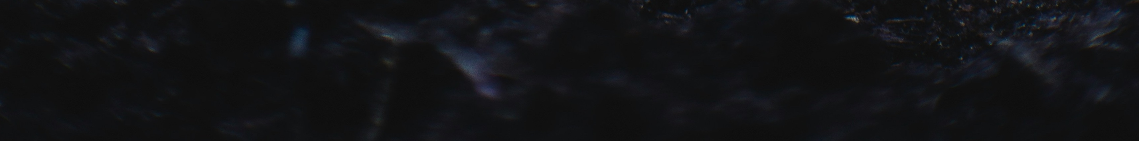
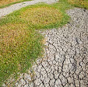
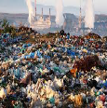
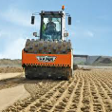
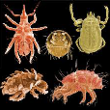
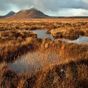
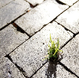
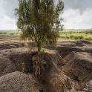
Why do we need to act?
Soil threats
Salinization & desertification
Pollution
Compaction
Loss of biodiversity
Organism matter decline
Land take & sealing
Erosion
EU Soil Observatory (EUSO) contribution towards healthy soils. European CommissionJoint Research Centre (JRC). Dr. Panos Panagos.
Notes:
Soil health is essential for life on Earth, providing essential nutrients to crops, clean water and the largest terrestrial pool of carbon.
Soil hosts more than 25% of all biodiversity and provides 99% of global food demand.
The EU is on a mission to restore and enhance healthy soils
Soil Threats:
Erosion, compaction, organic matter decline, pollution, loss of biodiversity, salinization, desertification, land take & sealing

Slide 5
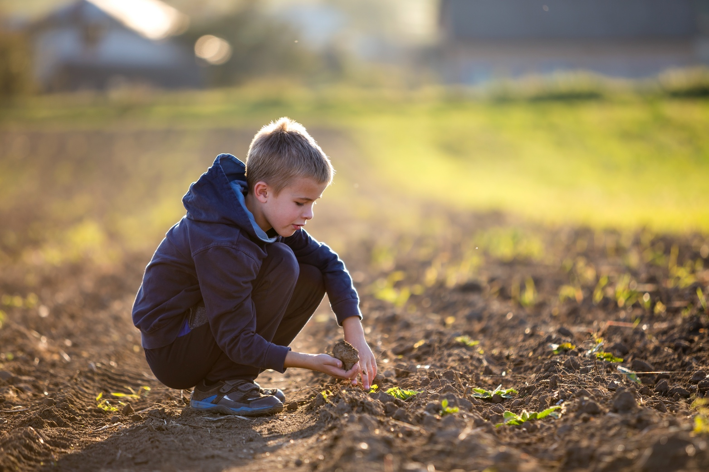
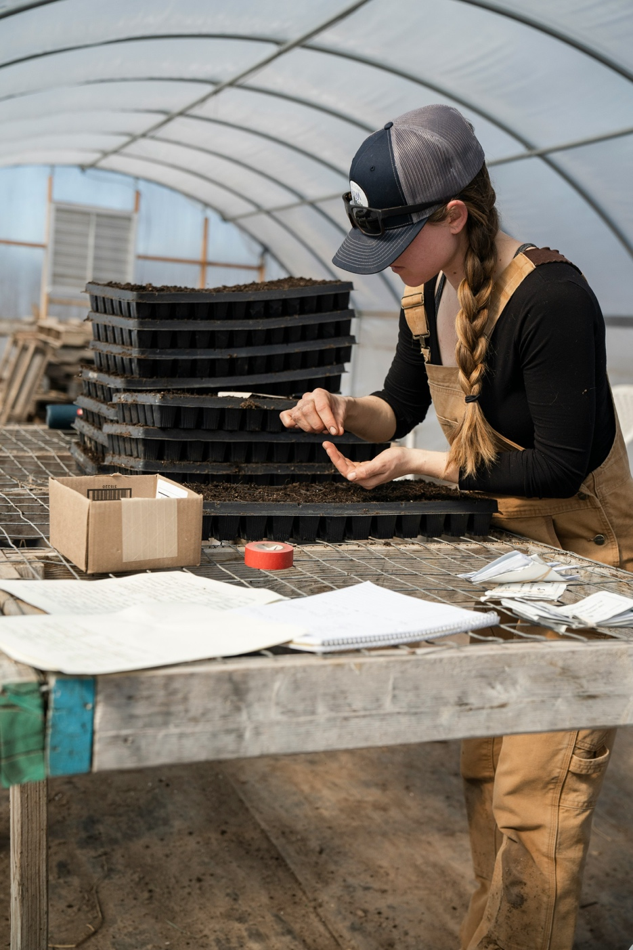
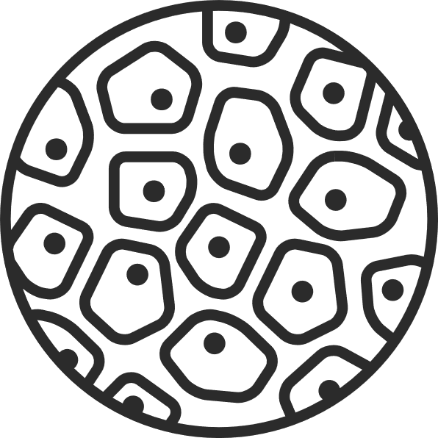
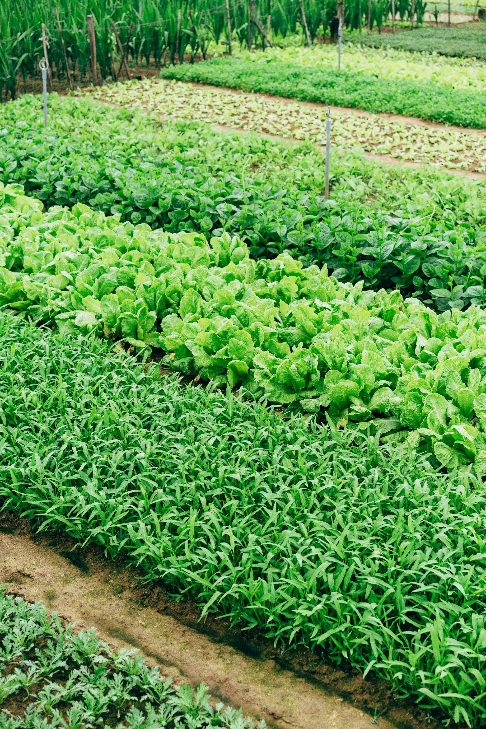

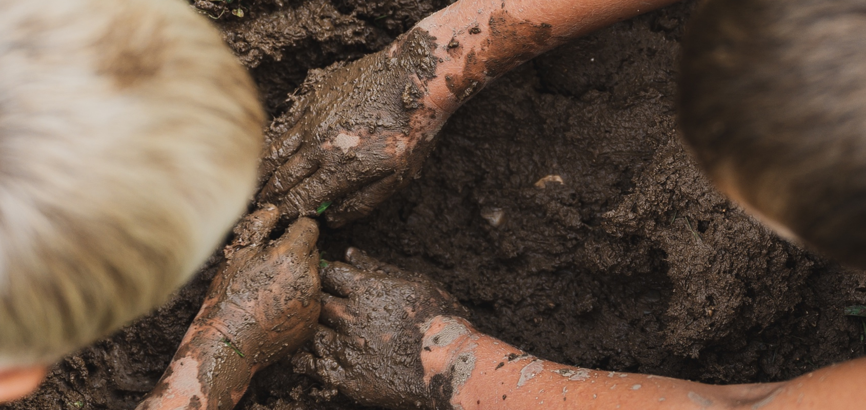
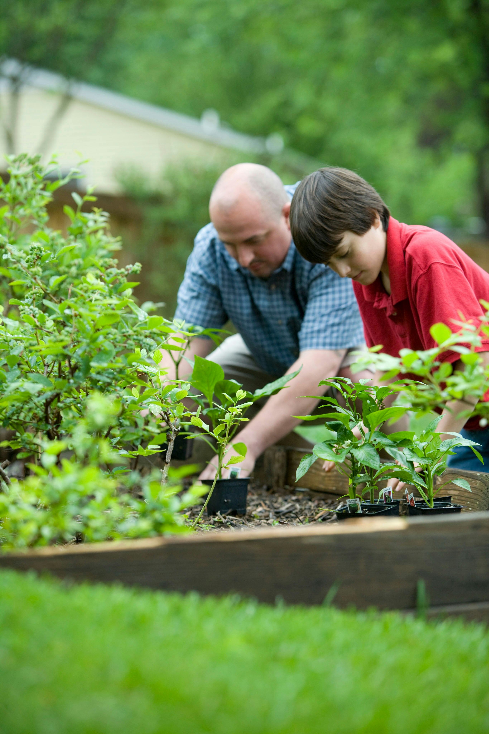


The importance of understanding the relationships between soil, ecosystems, and human societies.
Notes:
Understanding soil as a complex, interconnected system that supports life on Earth. It goes beyond basic knowledge of soil components and functions to encompass a deeper understanding of the dynamic relationships between soil, ecosystems, and human societies.
Interconnectedness: This would emphasize the holistic nature of soil systems and the importance of understanding their complexity and interdependence.

Slide 6

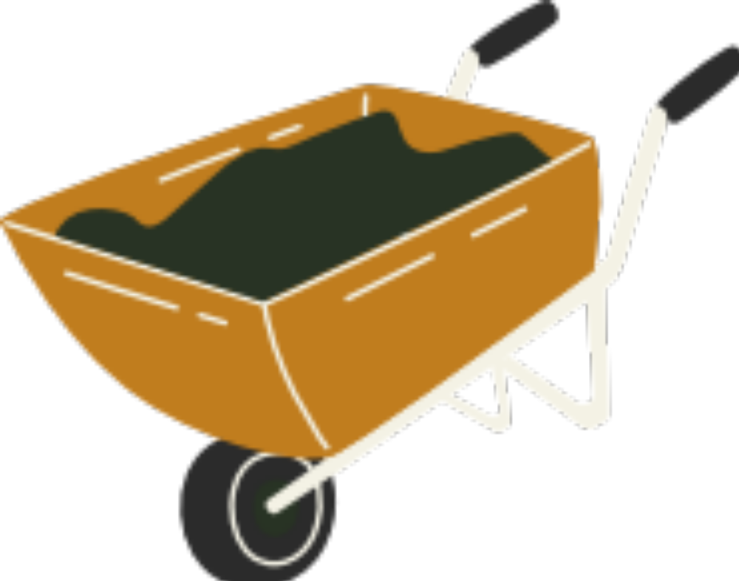
How and when?
CURIOSOIL aims to bridge this gap through immersive soil experiences, fostering a deeper connection between individuals and the ground beneath their feet.
The project started in February 2024 and will run for 48 months, working with partners across Europe to develop educational resources, set curriculum standards and implement teacher training initiatives to encourage wider adoption and dissemination of effective soil conservation practices.
Budget
5.9 M€
Duration
48
months
14
partners

Slide 7
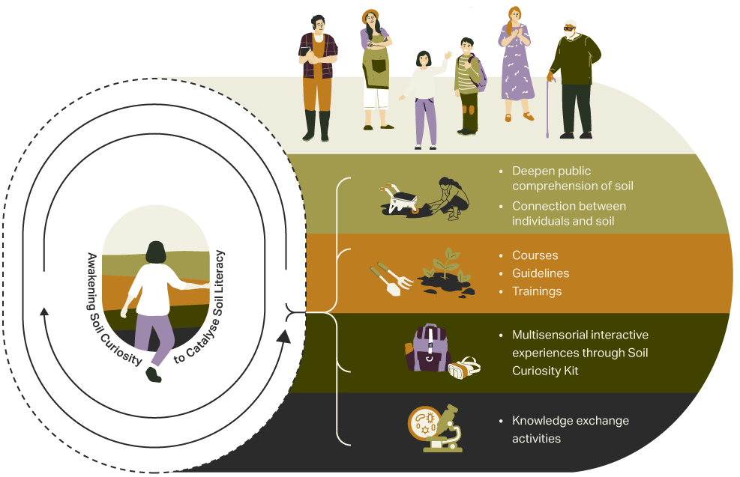
Project activities and objectives

Slide 8

Curiosity Kit
Video wiki
The Curiosity Kit will compile the project's main outcomes and offer multi-sensory soil activities for educators to provide enriching experiences.
Courses
Moocs
Trainings
Hackathons
Arthatons
AR/AV app
Notes:
The Curiosity Kit is a main component of the project. Full equiped with the Curiosity Kit

Slide 9
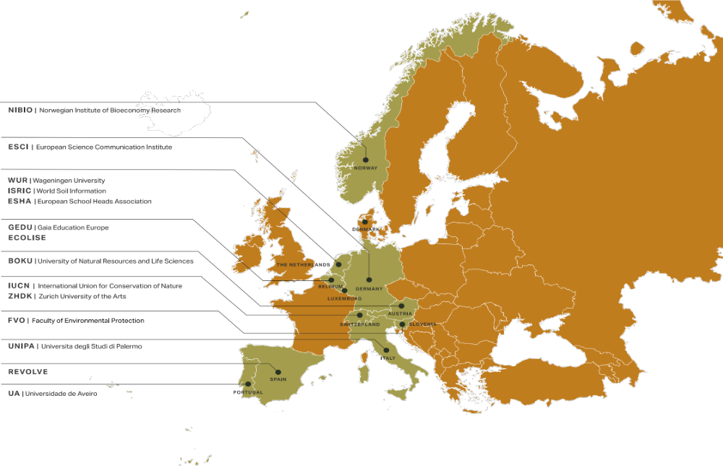
Who is behind?
14 European partners collaborating to enhance soil literacy, contributing their expertise in natural, educational, and social sciences.

Slide 10
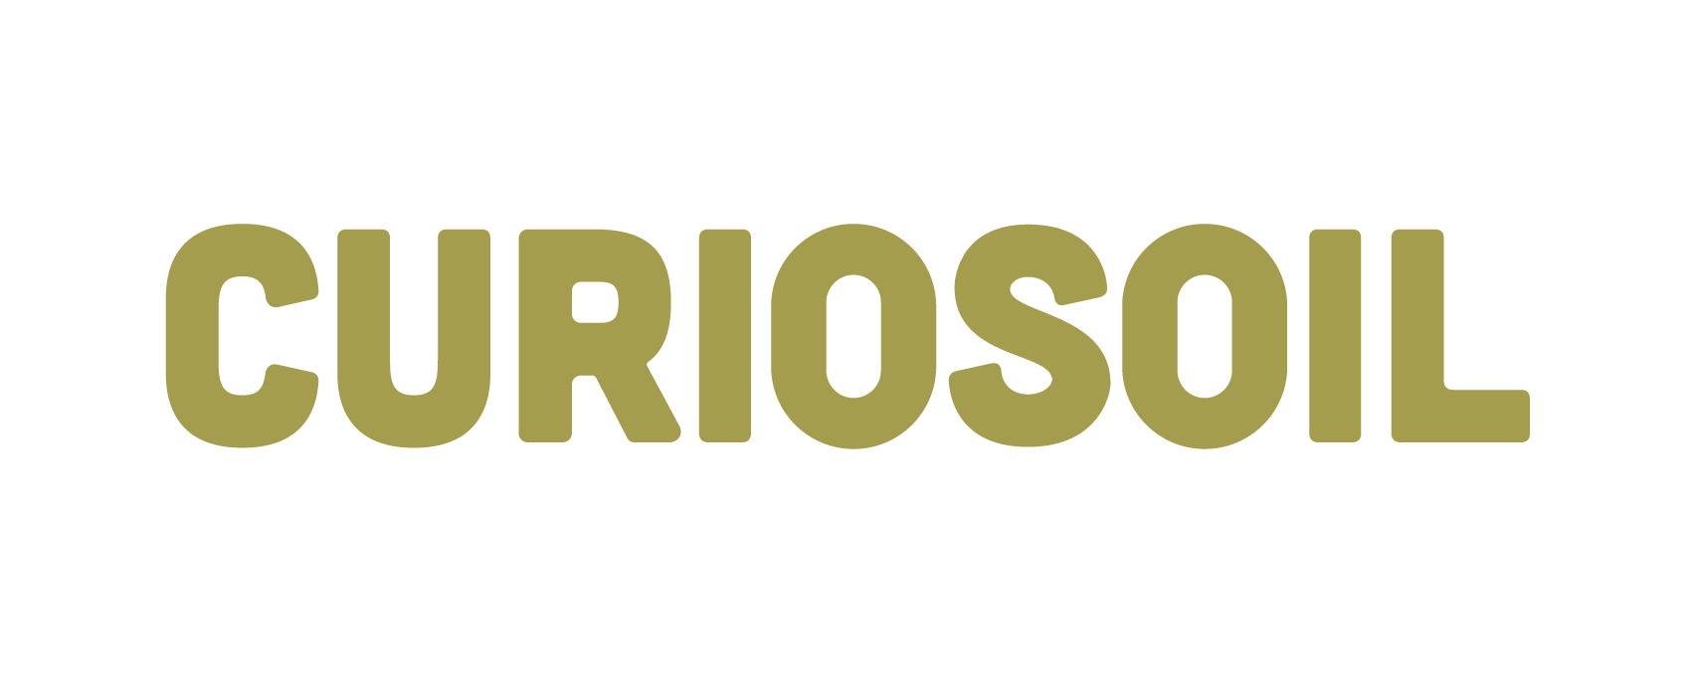
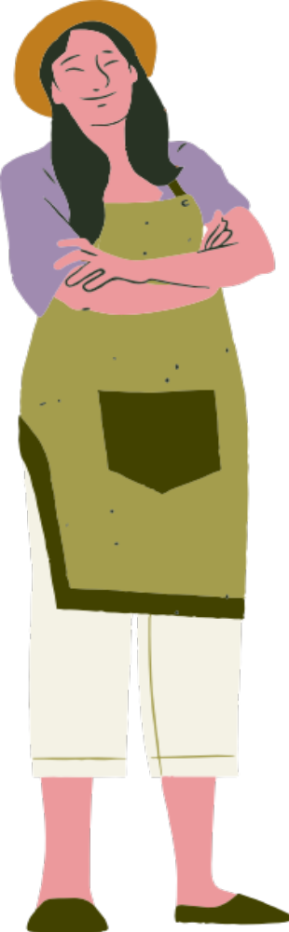
Join the CURIOSOIL Community and Shape the Future of Soil Education!

Slide 11
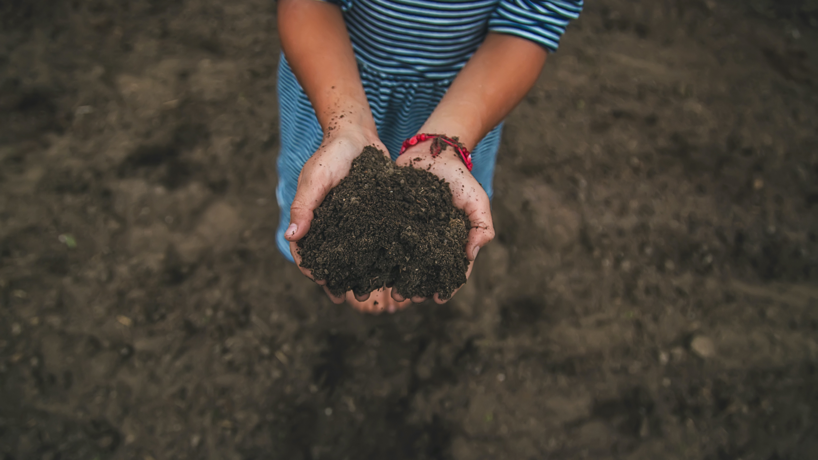



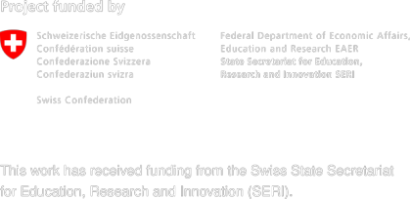

Thank you!
Thank you!
curiosoil.eu
curiosoil_project
CURIOSOIL Project

