Slide 1

The Sustainability Robot
A City for the Future
Koutsouli Aspasia
3rd Junior High School of Argyroupolis
Lower Secondary School
Funded by the European Union. Views and opinions expressed are however those of the author(s) only and do not necessarily reflect those of the European Union or the European Education and Culture Executive Agency (EACEA). Neither the European Union nor EACEA can be held responsible for them.

Slide 2

I will implement my scenario in:
Through 12 detailed lessons:
1️⃣ SDGs & Smart Cities (incl. Copernicus Earth Observation)
2️⃣ Robotics & Sensors
3️⃣ Ideation & Planning
4️⃣ Building Solutions
5️⃣ AppLab Design
6️⃣ Artistic & Musical Expression
7️⃣ Testing & Debugging
8️⃣ Presentation
9️⃣ Reflection
🔟 Virtual Exhibition
1️⃣1️⃣ Peer Review
1️⃣2️⃣ Job Shadowing Debrief
Through these lessons I will…
Introduce SDGs and sustainability challenges.
Enable students to analyze real satellite data (Copernicus) for their city.
Guide teams to design and build Eco-Robots with LEGO Mindstorms, SPIKE, micro:bit, or Nezha kits.
Support students in creating digital quizzes with AppLab.
Foster artistic creativity through posters, music (Soundtrap, AIVA, Suno), and 3D models in Tinkercad.
Help students present their solutions and evaluate their own and peers’ work.
Connect the scenario to European job shadowing experiences.
In the end of the project…
Students will present their Eco-Robots in a virtual exhibition, demonstrating their understanding of sustainability, robotics, and the SDGs. They will reflect on how technology can promote responsible citizenship.
lower secondary school
The duration of the implementation is:
12 lessons, each 45 minutes long
My scenario goals are:
How will I achieve my educational goals?
Empower students to understand the SDGs and the importance of sustainable cities.
Engage students in design thinking and collaborative problem-solving with robotics.
Develop green competences (GreenComp) through STEM, arts, and digital tools.
Enhance digital literacy with AppLab and 3D design using Tinkercad.
Promote creativity through art, music, and AI-powered tools.
Connect learning with real data from the Copernicus Earth Observation platform.
Remember that your scenario goals should be linked with Sustainability Citizenship.

Slide 3







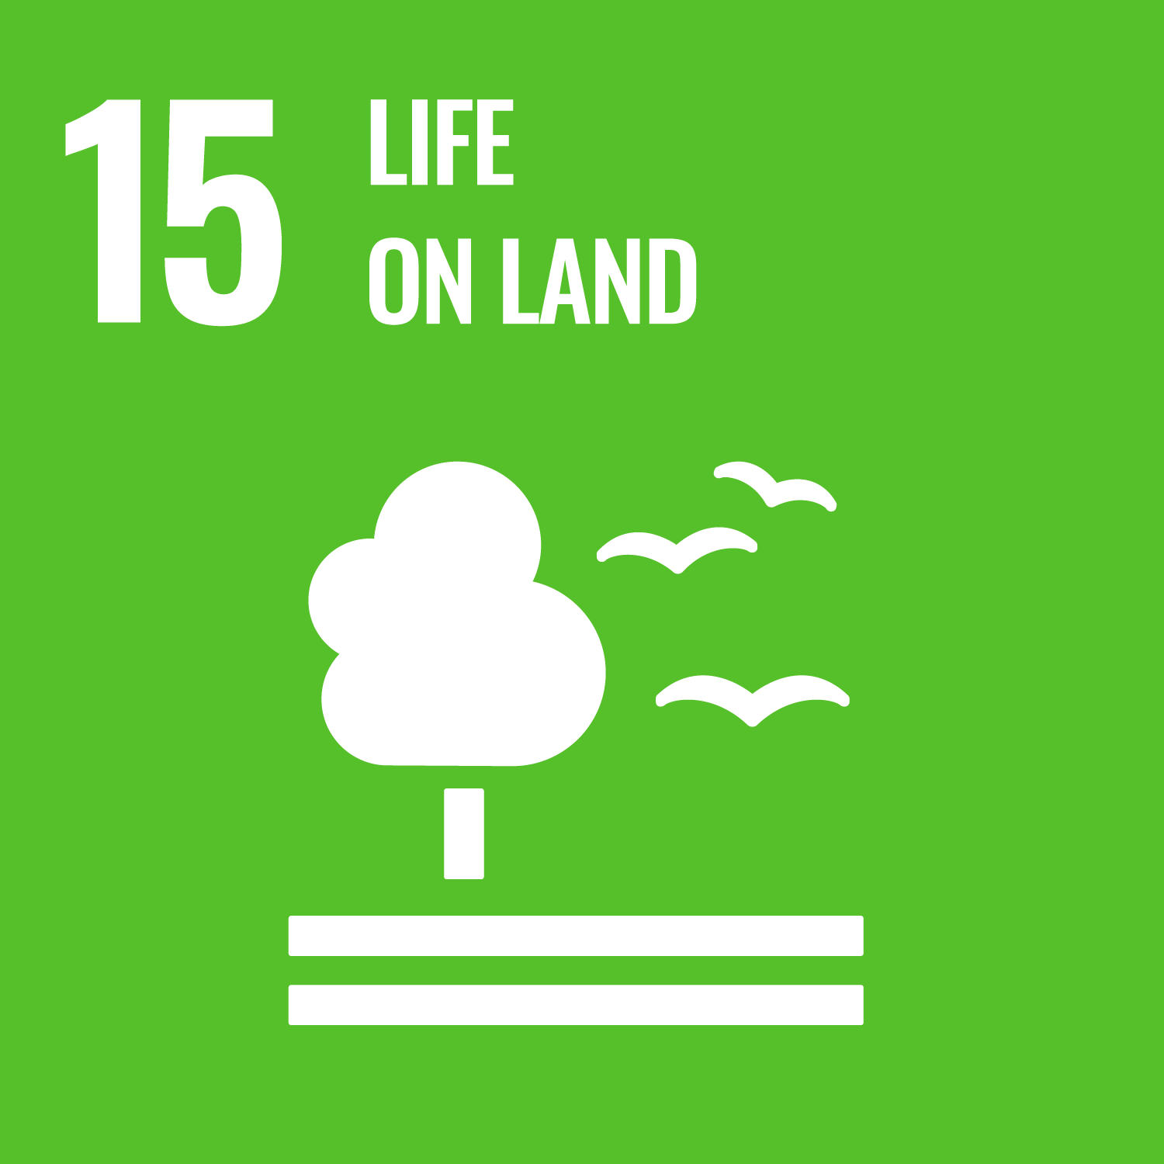


This activity links to the Sustainable Development Goals:
The green competences that promoted from my scenario are:
✅ SDG 6: Clean Water and Sanitation
✅ SDG 7: Affordable and Clean Energy
✅ SDG 9: Industry, Innovation and Infrastructure
✅ SDG 11: Sustainable Cities and Communities
✅ SDG 12: Responsible Consumption and Production
✅ SDG 13: Climate Action
✅ SDG 15: Life on Land
✅ SDG 16: Peace, Justice and Strong Institutions
✅ SDG 17: Partnerships for the Goals
Embodying Sustainable Values | Valuing Sustainability | Supporting Fairness | Promoting Nature
Embracing Complexity in Sustainability | Systems Thinking | Critical Thinking
Envisioning Sustainable Futures | Futures Literacy | Adaptability
Acting for Sustainability | Political Agency | Collective Action

Slide 4
I will collaborate with:
Local Environmental Education Center – provide environmental data, organize workshops.
Municipality Environmental Office – suggest local sustainability challenges.
Parents Association assist in exhibition organization.
Here is my plan for integrating this scenario in my school this year:
I will :
Implement the 12-lesson plans with students in 7th-9th Gymnasium.
Engage external stakeholders for real-world connection.
Organize a virtual and physical exhibition of students’ work.
Share outcomes with eTwinning or Erasmus+ partners.
Use outcomes from job shadowing visits to inspire new school projects.

