Slide 1
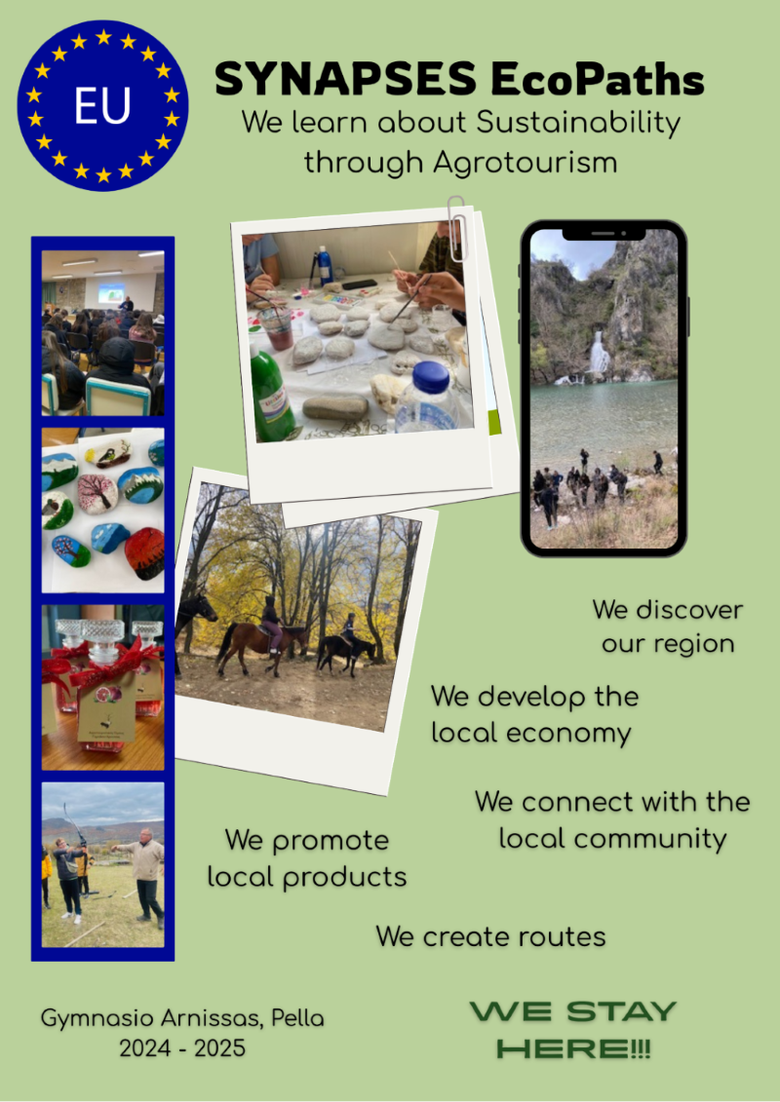

SYNAPSES ECO PATHS
We learn about Sustainability through Agrotourism
CHRYSI PAPANTONIOU
GYMNASIO ARNISSAS –PELLA
GREECE
SECONDARY SCHOOL
Funded by the European Union. Views and opinions expressed are however those of the author(s) only and do not necessarily reflect those of the European Union or the European Education and Culture Executive Agency (EACEA). Neither the European Union nor EACEA can be held responsible for them.

Slide 2

I will implement my scenario in:
2st grade
1st lesson: Introduction to tourism types and sustainability (2 hours)
2st lesson: Our Region’s Assets-Mapping local resources and cultural landmarks (2 hours)
3st lesson: Research & Interviews- Interviews with stakeholders and data analysis (4 hours)
4st lesson:Action Design-Group planning and route creation (6 hours)
5st lesson: Media Production- Posters, videos, QR signs, digital maps (6 hours)
6st lesson: Community Event & Dissemination-Presenting results to the school/local society
(4 hours)
7st lesson: Reflection & Evaluation-Journals, peer feedback, digital portfolios (3 hours)
Field Visits & Implementation, On-site data collection, event implementation (7 hours)
The duration of the implementation is:
34 hours
September-May
My scenario goals are:
How will I achieve my educational goals?
1.Understand the principles of sustainable and alternative tourism
2.Identify local resources with tourism potential
3. Collaborate to design an eco-tourism route
4. Engage in civic dialogue with community stakeholders
5. Produce digital content for public dissemination
6. Reflect on their roles as change agents for sustainability
Remember that your scenario goals should be linked with Sustainability Citizenship.

Slide 3

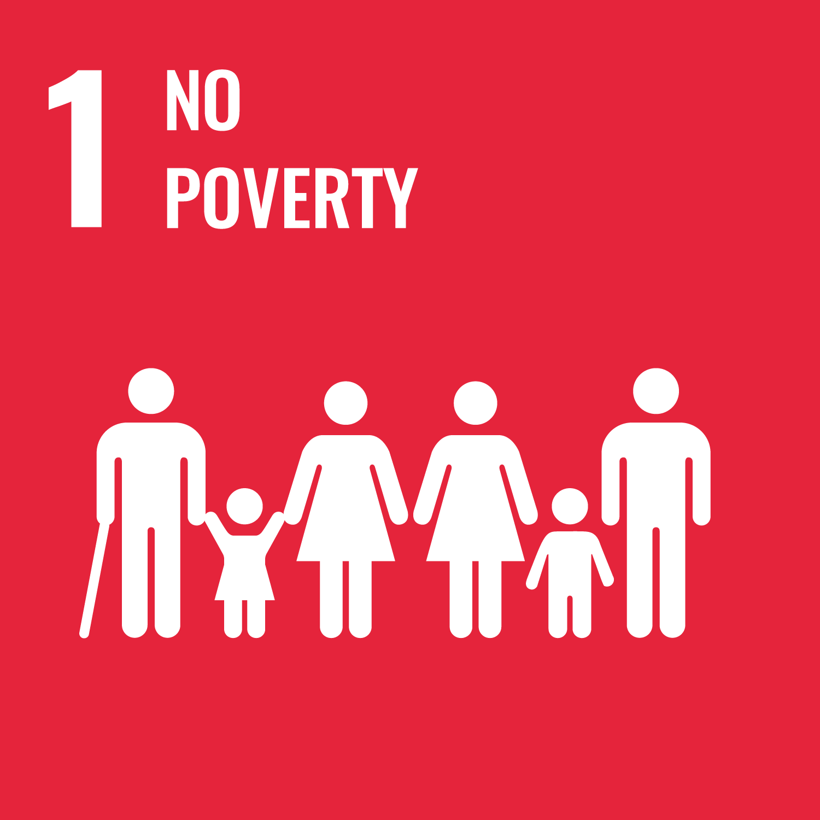


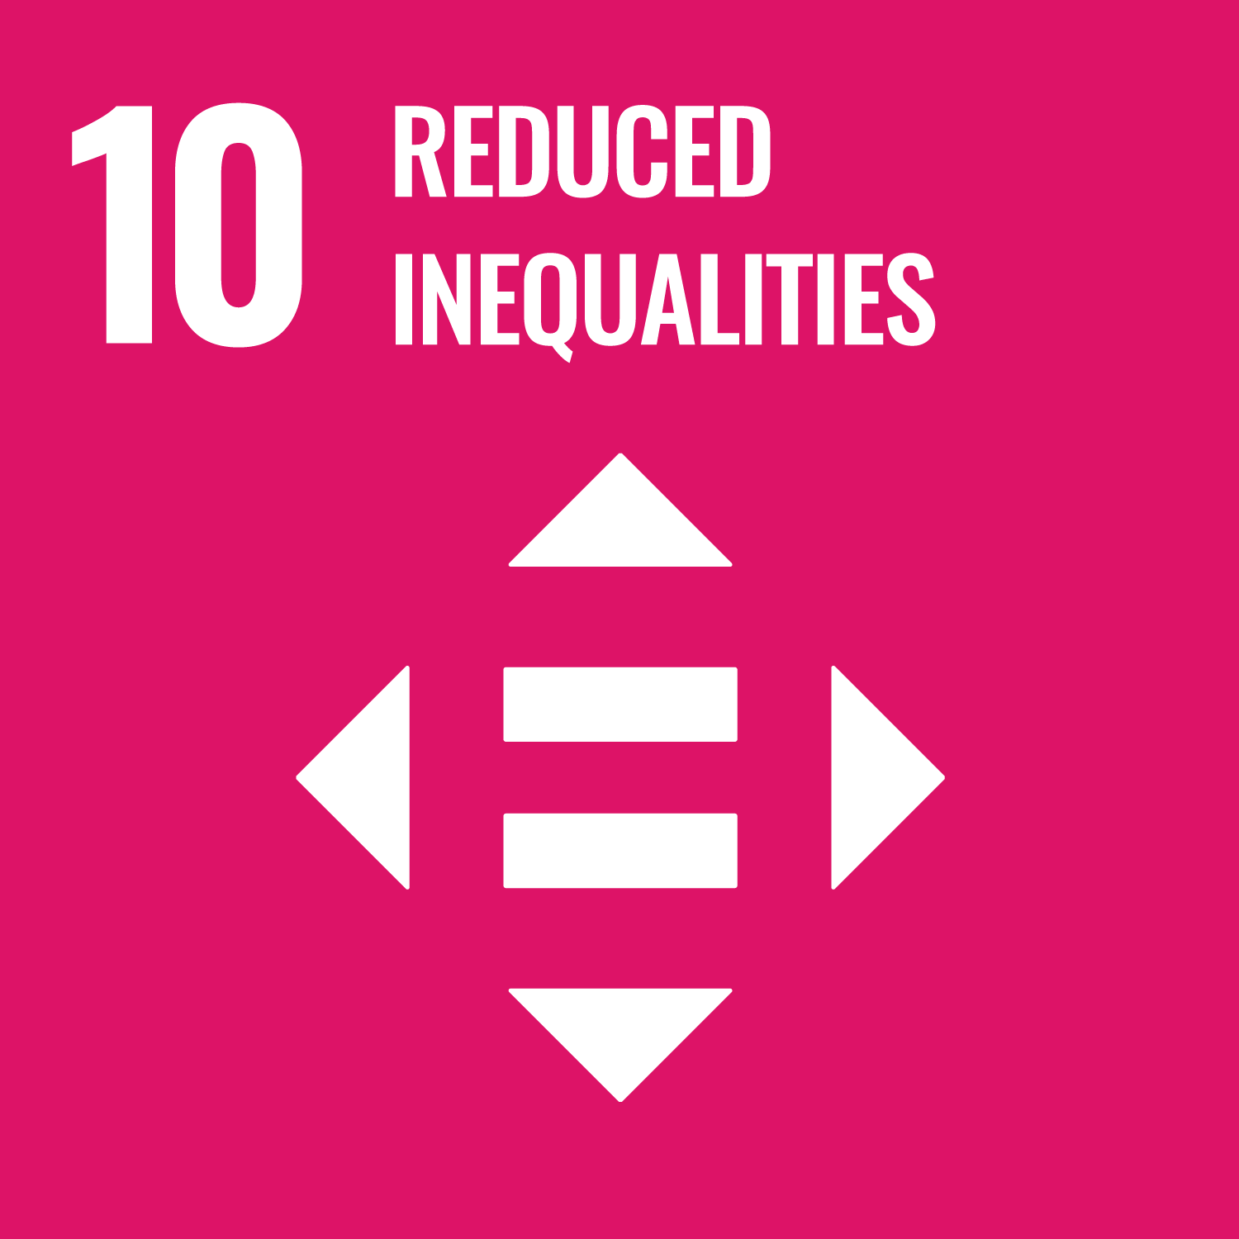
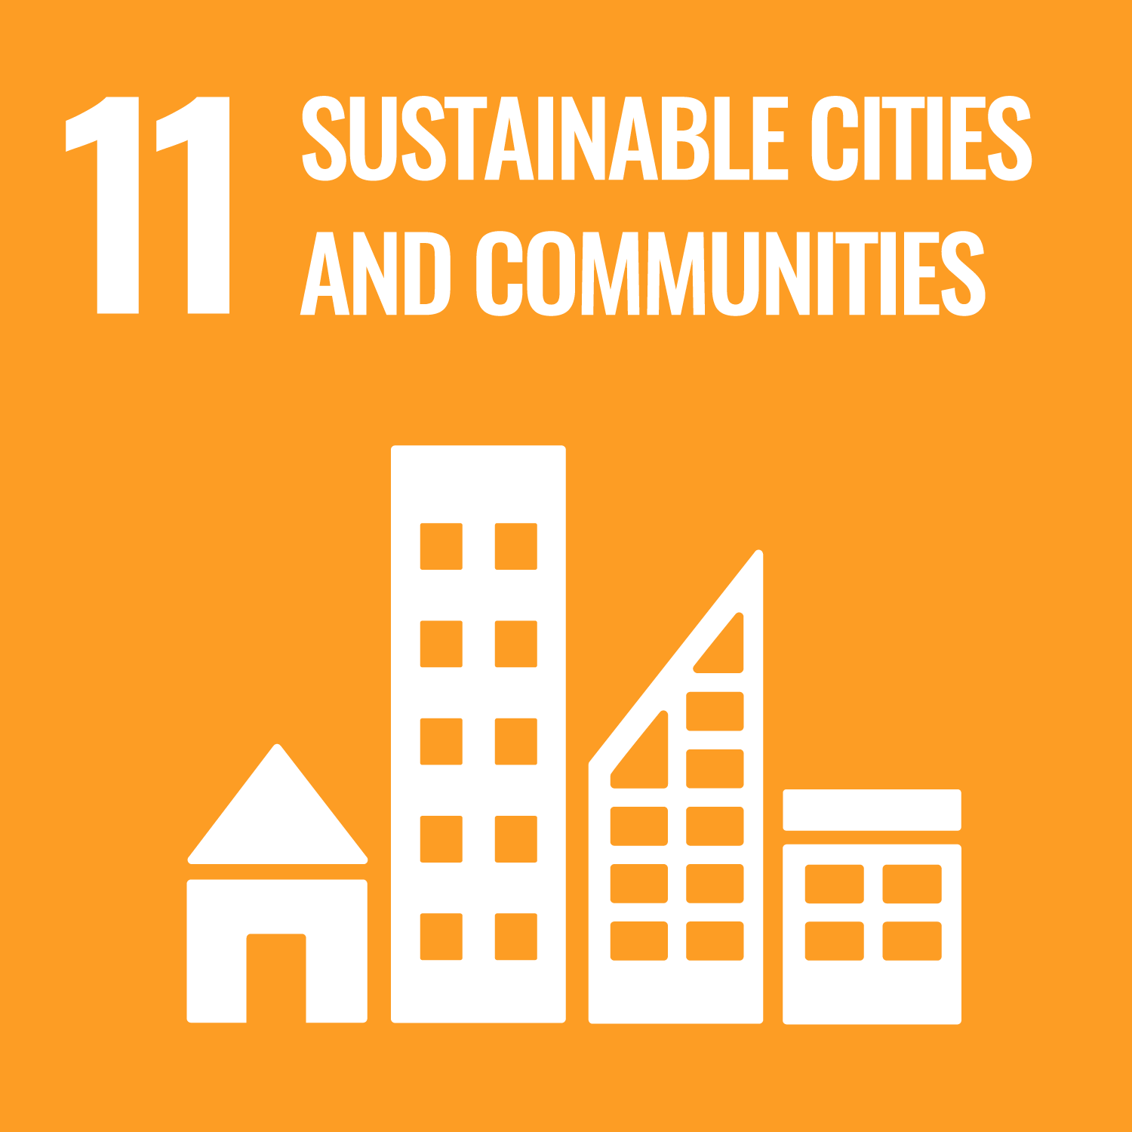

This activity links to the Sustainable Development Goals:
Select the goals you want and delete the remaining icons
The green competences that promoted from my scenario are:
Please keep the green competencies you want and delete the remaining
Embodying Sustainable Values | Valuing Sustainability |  | Promoting Nature
Embracing Complexity in Sustainability | Systems Thinking | Critical Thinking
Envisioning Sustainable Futures | Futures Literacy | Adaptability | Exploratory Thinking
Acting for Sustainability | Political Agency | Collective Action

Slide 4
I will collaborate with:
-NGOs (Non-Governmental Organisations),
-PTA (Parent-Teacher Association)
-Local business (Local cultural/environmental associations), Agro-tourism farms, traditional producers Municipality (Tourism Dept), KPE/Environmental Education Centers
Here is my plan for integrating this scenario in my school this year:
The scenario “SYNAPSES EcoPaths: Exploring Sustainability through Agrotourism” can be embedded into the school curriculum for the 2025–2026 academic year as part of the Environmental Education Program or the Skills Workshops. It can also complement subjects such as Geography, Home Economics, ICT, and History through an interdisciplinary approach. The project could be officially launched in September with introductory sessions and team formation, followed by field research, planning activities, and collaboration with local stakeholders throughout the year. The implementation and community engagement phase can take place during spring months, leading to a school-wide or local community event to present the outcomes. Reflection and evaluation activities will conclude the cycle in May. Onother expanding option is to incorporate the scenario in specific curricula (specific units) by collaborating with other teachers in the school. By incorporating this scenario, the school will enhance students’ active citizenship, environmental literacy, and digital skills, while also strengthening ties with the local community and aligning with the goals of the SYNAPSES network and GreenComp sustainability competences.

